Slide 1
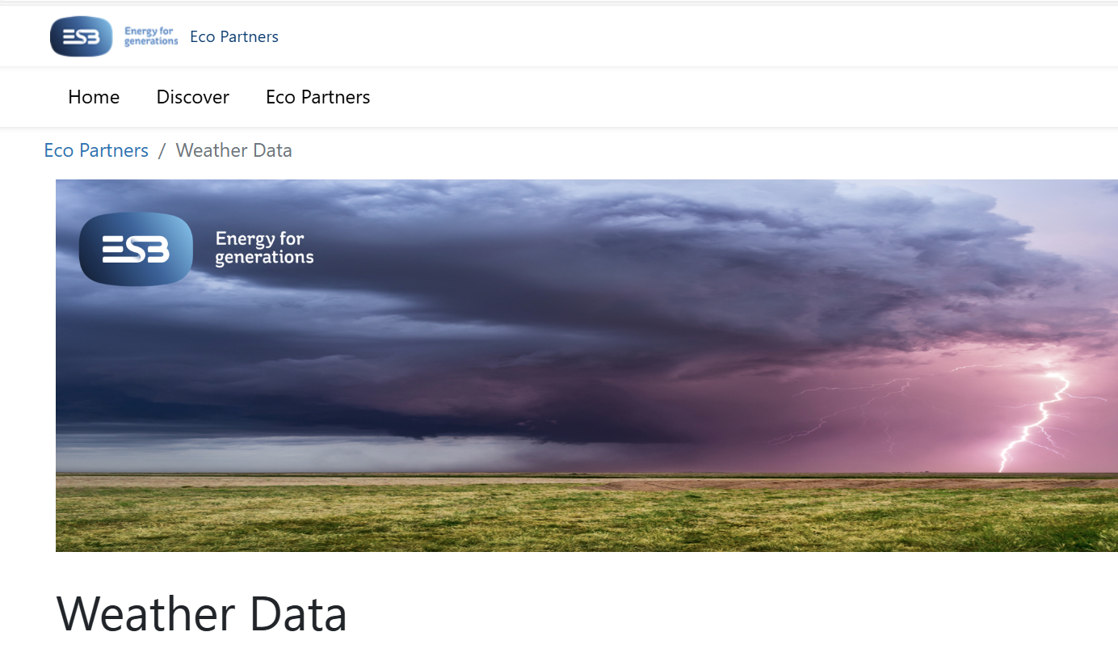
Challenge

Slide 2
Weather Forecasting Challenge
The Opportunity for Solution Suppliers

Slide 3
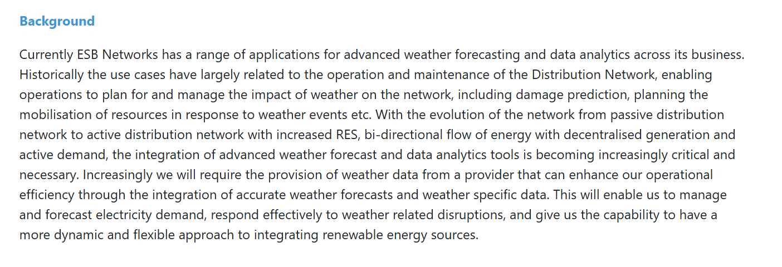

Slide 4
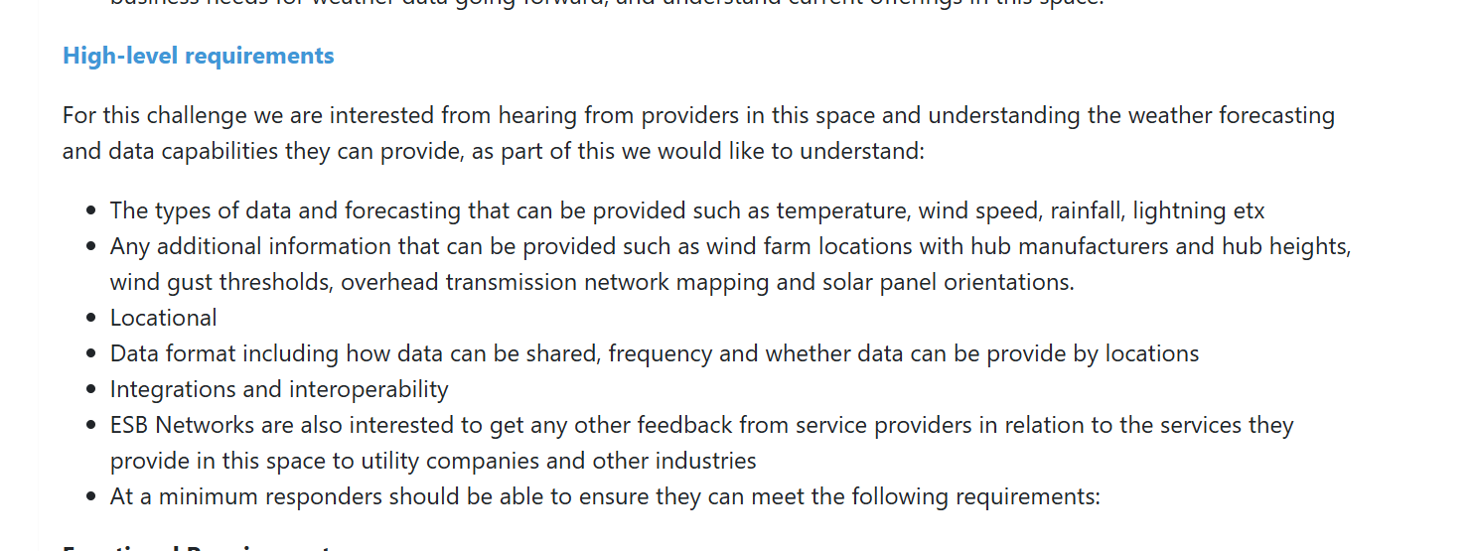

Slide 5
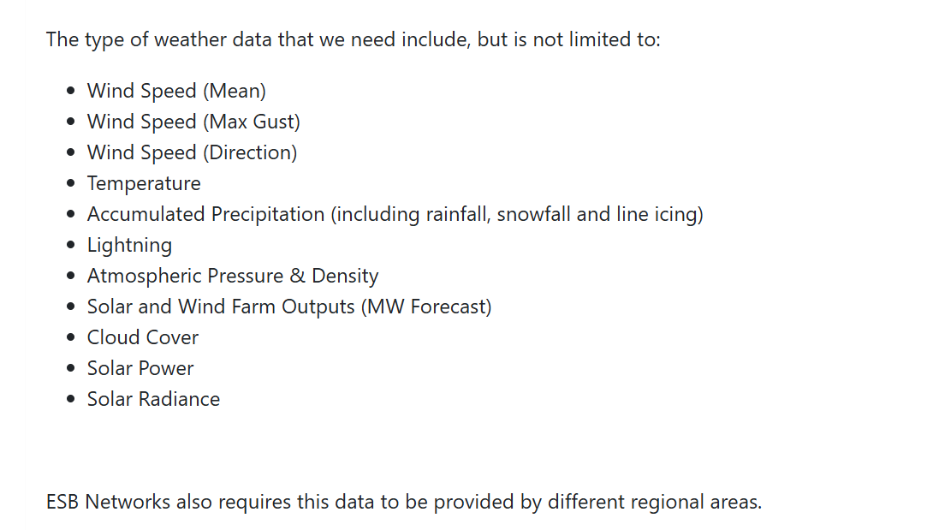

Slide 7
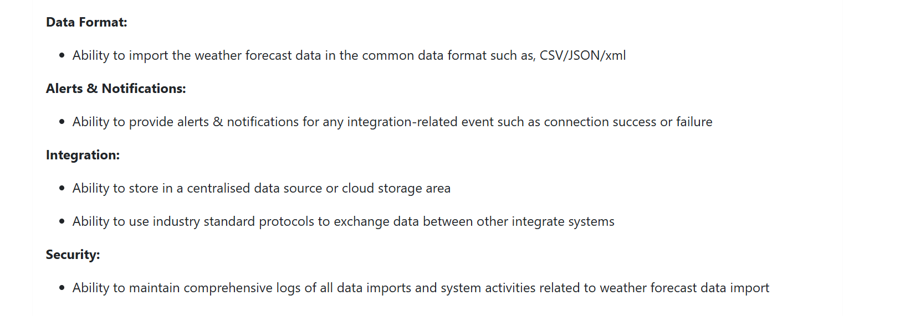

Slide 8
Submission Guidelines
To make a submission for this challenge, please use this template ensuring that all questions have been answered.
For this particular challenge, Skillnet Innovation Exchange and ESB have agreed to trial a process whereby Members of Skillnet Innovation Exchange can participate in responding to the ESB challenge. This means that the Innovation Exchange will require any SME that wishes to make a submission to accept the ESB the eRFP document as provided here.
Please send all submissions in word format to info@theinnovationexchange.ie by COB Wednesday 19th June including the following confirmation by email:
“I _________ of [SME Name] confirm that I have read and understood the ESB networks eRFP document and that I accept all terms and conditions as detailed therein”.

