Slide 1
Sport Ireland Coaching Digital Challenge Skillsnet Innovation Exchange Programme 27th June 2024

Slide 2
Notes:
Coaching Unit is one department/unit of Sport Ireland. Support the education and training of coaches in Ireland by working in partnership with 55 NGBs

Slide 3
NGBs
(x 55)
Coach Education

Slide 4
Background
Bespoke Coaching Database to track coach education (e.g. courses, coaches, trainers)
Developed in 2008 (16 years old)
Other features include digital certificates, analysis and reporting
>266,000 profiles, >29,000 courses
Online database accessible to NGBs and learners
API link to interface with NGB systems e.g. GAA
Tweaks/improvements e.g. digital certs, MFA, more gender options, GDPR features
Notes:
Database is on Azure and has recently been updated to SQL express and .net Sport Ireland Coaching own the source code for the database

Slide 5
The Problem
Outdated – 16 years old
Costly to add new features
Uploading information to the system is onerous and time consuming for Sport Ireland and the NGBs
Reporting/Analysis is basic and clunky. No visual representation
Front End User Experience is basic and not user friendly
Lots of dupes and legacy data that needs to be cleansed
Needs to be more agile and move with the times e.g. GDPR requirements, FOI requests, new features like CPD,
Not able to record education and training from other SI Units
Unable to store programme/award documentation

Slide 6
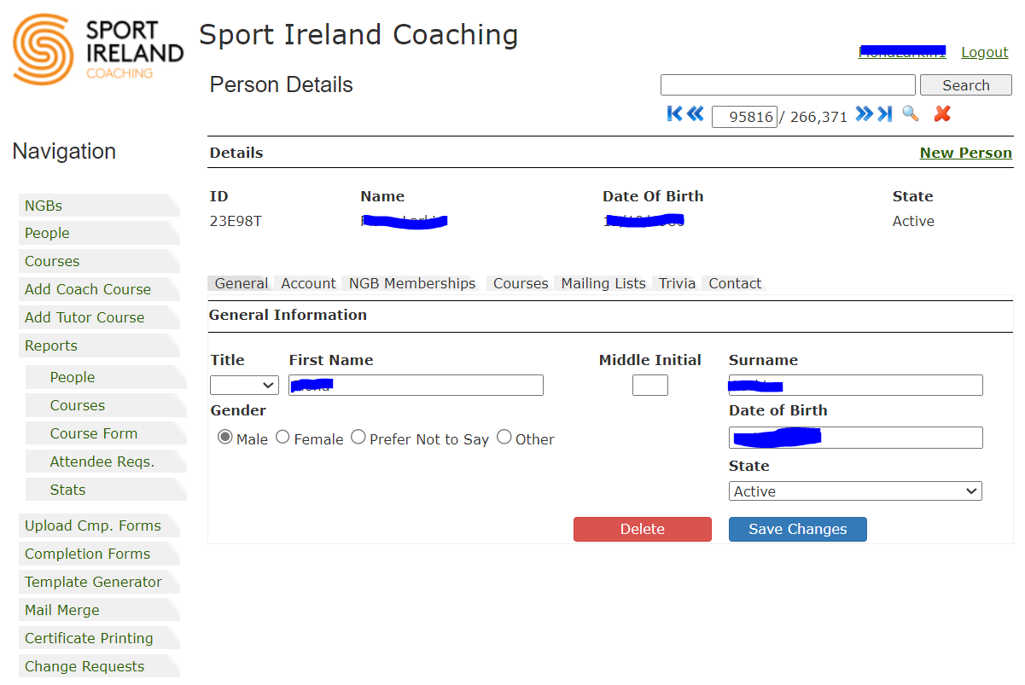

Slide 7
The Ask!!!!
System that incorporates a database and LMS (if possible)
SAS solution (hosted externally) with browser-based access (publicly accessible for all common browers)
Ability to interface with other systems e.g. NGB & Sport Ireland systems
Role-based access control – different levels fo access for different types of roles
Tracks ALL Sport Ireland education and training (not just coaching) including courses, learners, trainers etc
Tracks learner progress – CPD, accumulation of credits, digital certs, digital badges
Ability to upload information quickly and efficiently for all (Sport Ireland and NGBs)
Reporting features – detailed, quick, visual representation
Ability to store programme documentation e.g. syllabi and course materials by organisation, level, validation dates
Migrate data from existing system to new system

Slide 8
Thank You & Questions

