Slide 1
Copper + Aluminum bar storage.

Slide 2
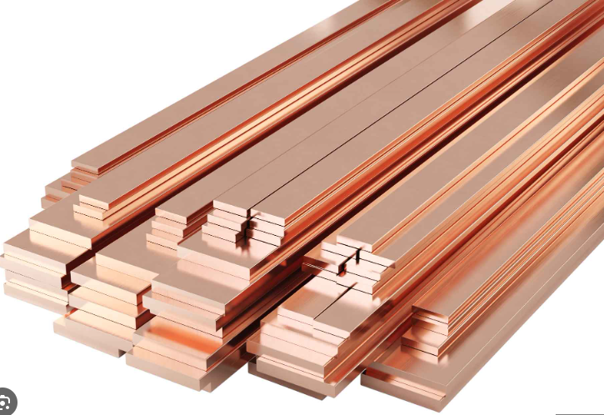
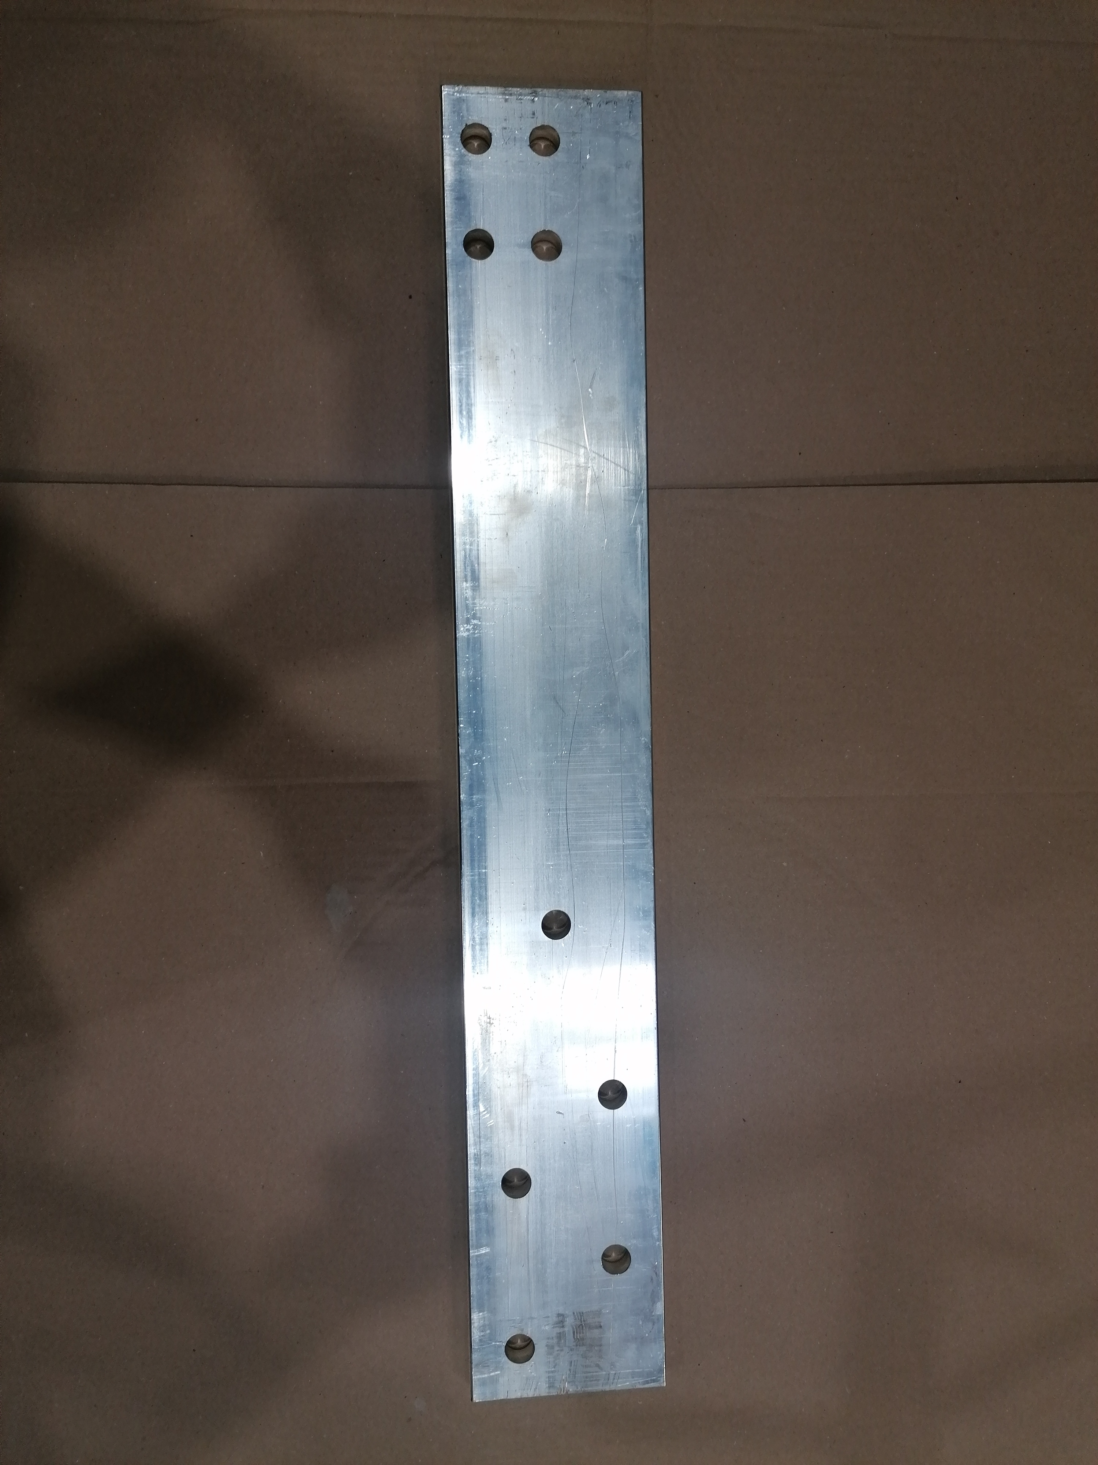
Copper + Alu bars from 30x3-200x20 up to 6mts long

Slide 3
Current Delivery of raw product in boxes.

Slide 4
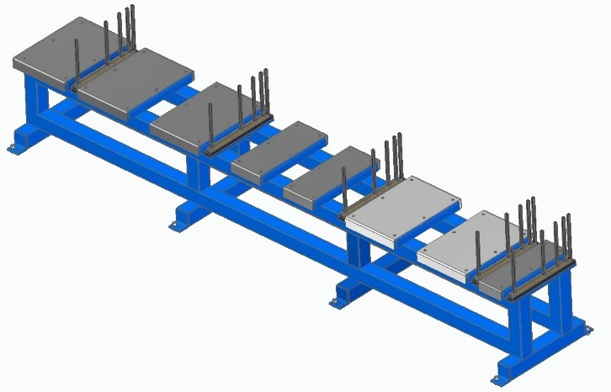
Machine Current option

Slide 5
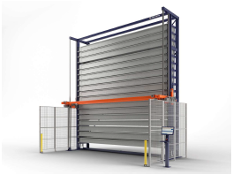
Possible solutions

Slide 6
Thank you.

