Slide 1
Digital For Sport
Challenge
14/11/24

Slide 2
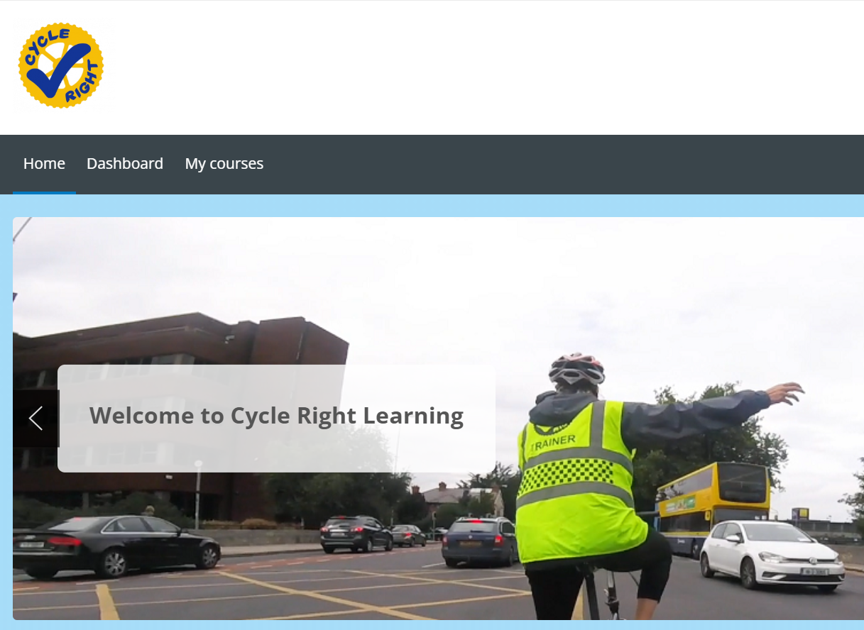
Cycling Ireland (CI) currently provides road safety awareness and safe cycling e-learning modules.
There are currently 2 e-learning courses:
Road Users
Parents and Guardians

Slide 3
Why are we here?
Modernise and Reflect Brand ID
Current content is dated
(a) Current courses require redevelopment
(b) Hosting provider
User Friendly
Current format and interface is cumbersome and difficult to navigate
Hosting
Requires a platform that issues auto-certification and provides user data readily and easily

Slide 4
Purpose and Uses of the E-learning Course
Informing all Road Users
The development of a modern e-learning cycling safety and road awareness course will provide the foundation for all current coaching and education programmes.
An efficient e-learning solution will expand the reach of Cycling Ireland to more cyclists and road users, providing essential education on safety awareness and safe cycling skills.
Allowing for education and upskilling on demand
For Education Programme participants
Streamline program delivery
For Coaches, Parents and Educators
Provides a vital tool for education or homework element to maintain engagement between practical course contact time

Slide 5
Thank You

