Slide 1
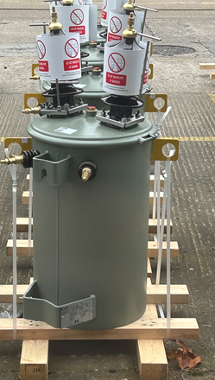
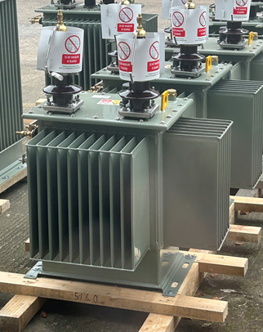
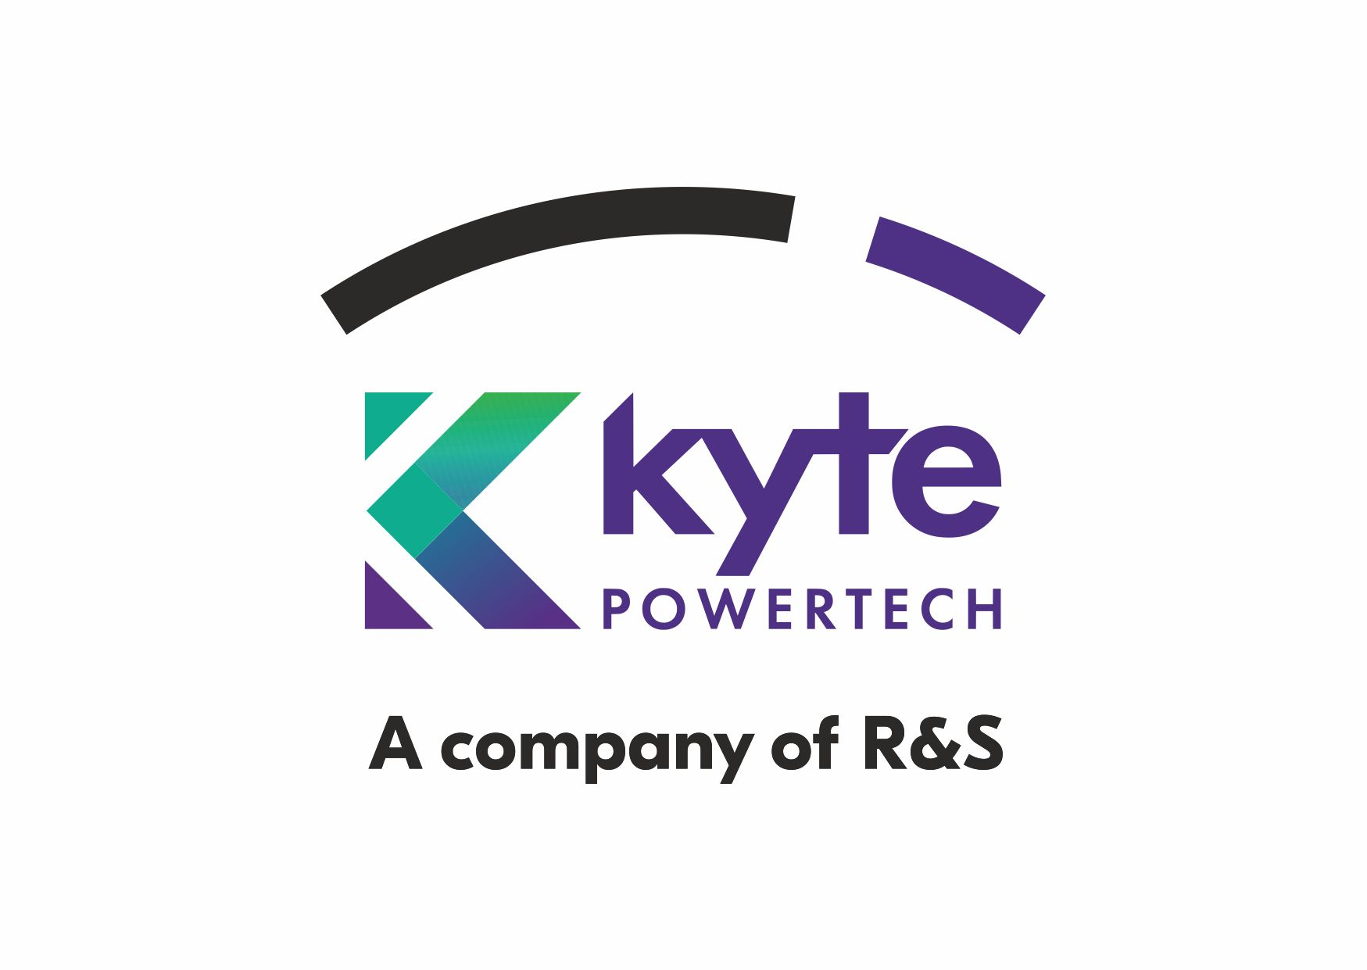
Transformers Type
Round Transformer
Square Transformer

Slide 2
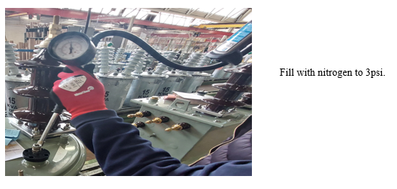
Leak Test: Previous Process

Slide 3
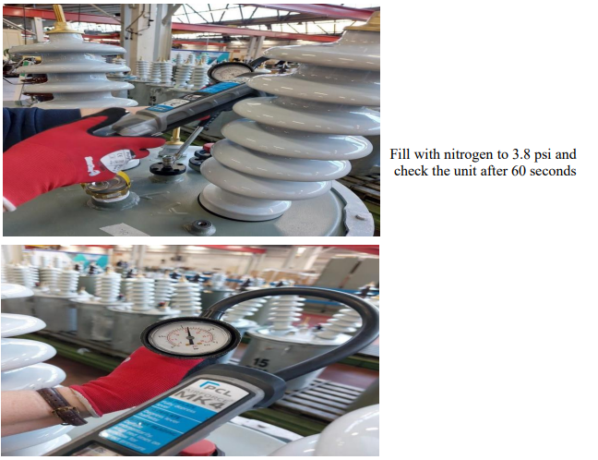
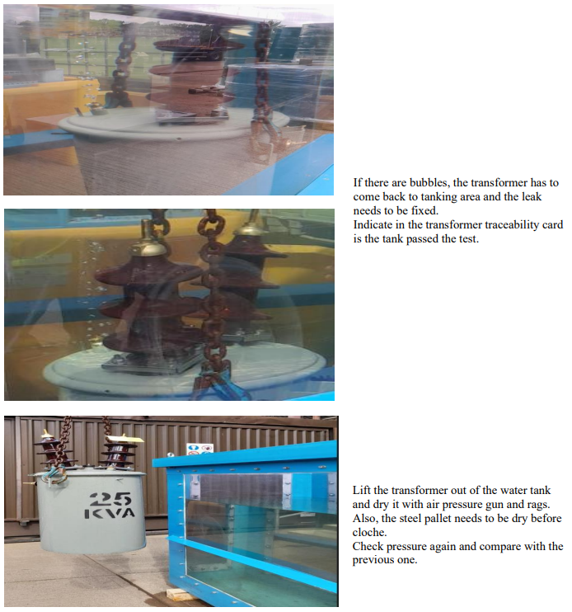
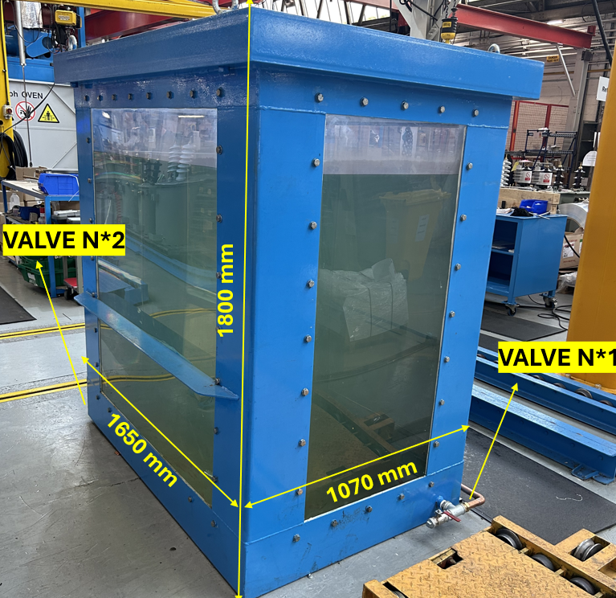
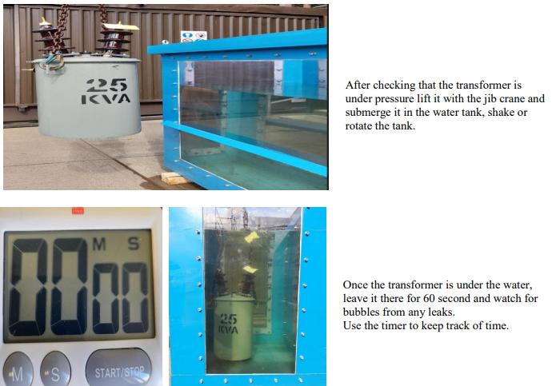
Leak Test: Current Process

Slide 4
Opportunity for Improvement: Drying Process
The current drying process is manual and inefficient, relying on air guns that are too noisy and basic rags. Automating this process or introducing more efficient tools could significantly reduce noise and improve overall productivity.

