Slide 1



THE PEMBROKE APPROACH DELIVERING RESULTS THAT LAST 31 October 2024

Slide 2
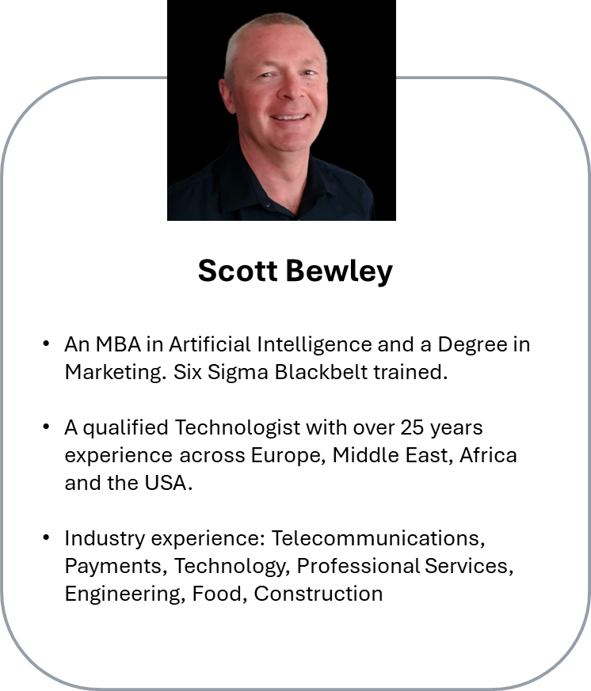
TABLE OF CONTENTS
your speaker today
01
04
Who are we
Who is here today
02
05
What we do
A Case Study
03
06
Who we work with
What we are looking for
DELIVERING RESULTS THAT LAST

Slide 3

















Who are we?
Full-service agency with 40+ expert consultants
deep domain EXPERTISE
An average of 20 years experience
Cyber
Experts
Business
Transformation
Managed
IT Services
Digitalisation Experts
Environmental & Energy Specialist
Commercial Export Specialists
Lean Practitioners
(Master Blackbelt)
Process Engineers
Certified Health & Safety
Accountants (CIMA)
HR & Recruitment Specialists

Slide 4
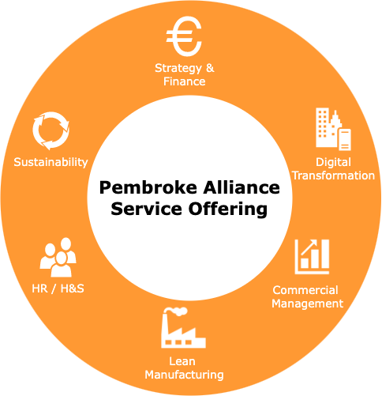
PEMBROKE ALLIANCE
What we do
Implement Efficiencies with Savings Ranging from €20k to €3m+
We are a Multi-Discipline, full-service agency priding ourselves on building long-term, collaborative relationships while delivering results that last for our clients.
Our mission is to help clients build profitable businesses, by empowering them to make continuous improvements that deliver long-lasting results.
We provide an extensive range of consulting services, passionately delivered by a team of industry experts, who have hands on experience working with and leading businesses across multiple industry sectors.
Strength & depth enables PA to deploy highly focused and relevant specialist teams to any project.

Slide 5
SUCCESS STORIES
BUILDING CAPACITY
TURNAROUNDS
FROM ZERO EXPORTS
DIVERSITY
hi
Cooked Food facility
Implemented and embedded a Culture of Lean to develop capacity to allow the company to Grow.
Turnover up from €5m to €13m EBITDA Margin up from 5% to 11%
Lean Plus x2 Green Start
Digitalisation R&D
Capital Support
Engineering
Business working off a
Net margin of 2-3%.
Generated Savings of €425k per annum by
Redesigning layout, transferring operations to 1 site building capacity by 25%
Reduction in cycle time allowing for increased production.
Developed real-time KPI Dashboards using Power BI
Traceability system (QR code)
Quality data allows the business to identify problems sooner and amend them.
Furniture
The business at the time, was at a crossroads considering the decision to change its operation and product offering.
Helped to realise a 3-Fold increase in capacity with the same number of staff as 5 years ago. Currently working together on continuous improvement and new market development.
Turnover has Doubled
Now Exporting (25% of T/o)
Lean Plus, Digitalisation,
Green, Sales Strategy
Food Production
The relationship goes back 10 years when Pembroke Alliance were asked to perform a health check and look at the current operations and future plans.
The business at the time, was deciding to move its operation to fully Gluten Product
Turnover up from €7m to €35m
Lean Transform Digitalisation
Green R&D
hi
DELIVERING RESULTS THAT LAST

Slide 6







Government Agency example
Digital Roadmap with EI
Step 1 – Digital Discovery
Offers 80% of up to €6300
Output
Assess Current Architecture and Build Future Needs Roadmap
Can lead in to either or BOTH
Strategic Consulting or
Digital Process Innovation
Step 2 – Strategic Consultancy Grant
Offers 50% of up to €70k
Output
A Feasibility of a project
Use to scope and develop a plan for an ERP or technology roll-out.
Step 3 – Digital Process Innovation
Offers up to €150,000 (50% grant aid) in support
Incentivise and support companies to invest in
Implementation of new or significantly improved digital production methods,
digital service delivery or organisational methods
that will increase their operational effectiveness, leading to greater productivity and competitiveness.
The maximum grant rate is 50% of the eligible costs, up to a maximum grant of €150,000 split 50:50;
Internal Support of €75k Max
External Support of €75k Max
Other Government Agencies we work on behalf of our clients

Slide 7
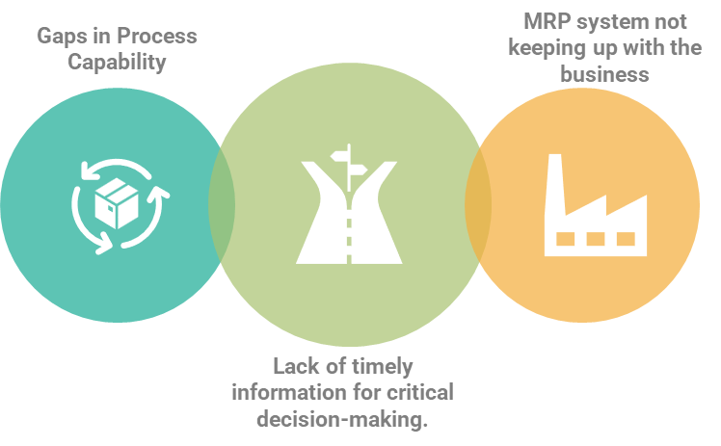
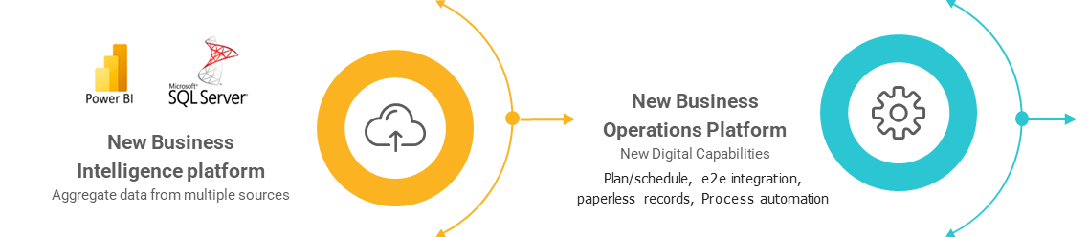
CASE STUDY
A Food Industry Client
Problem
Solution
A digital assessment identified three main issues:
Gaps in digital capability to support end-to-end processes.
Lack of timely management information to support critical business decisions.
The MRP solution not keeping pace with the growth of the business.
Phase 1. A New Business Intelligence Platform
Phase 2. A New Business Operations Platform
Phase 1
Phase 2
Notes:
Phase 1: Introduce a new Business Intelligence Platform; the scope was to design, build and commission a platform to aggregate data from multiple source systems (primarily Emydex and SAGE200) to provide timely management information to support key decision making. This solution would be built on Microsoft SQL Server and Power BI reports. The solution would be designed in such a way to allow for additional data sources to be added as we grow.
Phase 2: Introduce a new Business Operations Platform; the scope was to procure and deliver a modern Business Operations Platform to support growth in the business, reducing total cost of ownership and reliance on limited skillsets. The platform would also provide digital capabilities missing in the current solution – production planning/scheduling, end-to-end integration, paperless records and process automation/orchestration
reducing operational inefficiencies, empowering people to make better decisions and ultimately enabling growth ambitions.

Slide 8

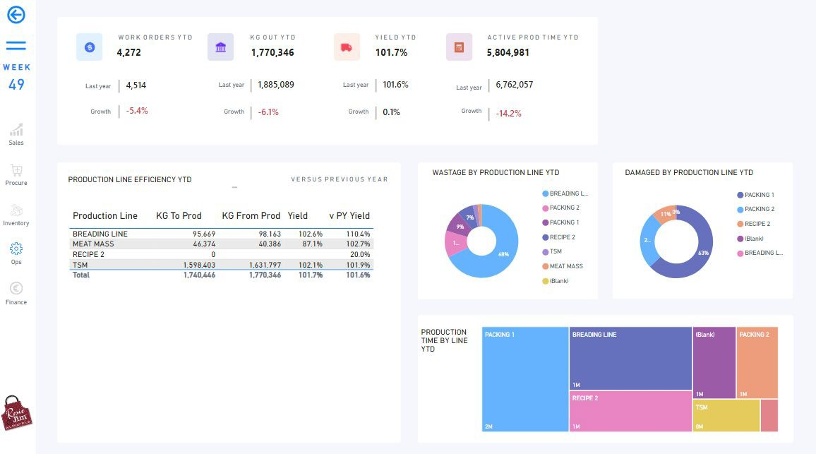


Results
Improved source data quality with new processes in place to monitor and maintain this
Automated, daily refreshes of key business reports, readily available and distributed to stakeholders
More advanced insight into business performance allowing better decision making
Future Steps
Real-time reporting of production floor equipment/lines (OEE)
More advanced modelling of business costs and therefore margins (transport, labour etc.)
Fractional CIO Activities & Outputs
Purpose: Structure the client’s IT function and train the new IT Lead.
Business Benefits:
Cyber Security Training for all management staff
Negotiated commercial agreements with key IT service providers
Introduced quarterly service reviews with primary IT providers
Companywide asset audit and asset register updated
Delivery of new wireless infrastructure
Introduction of SharePoint document management capability
Introduction of IT service desk (Jira)
Business Continuity Test

Slide 9

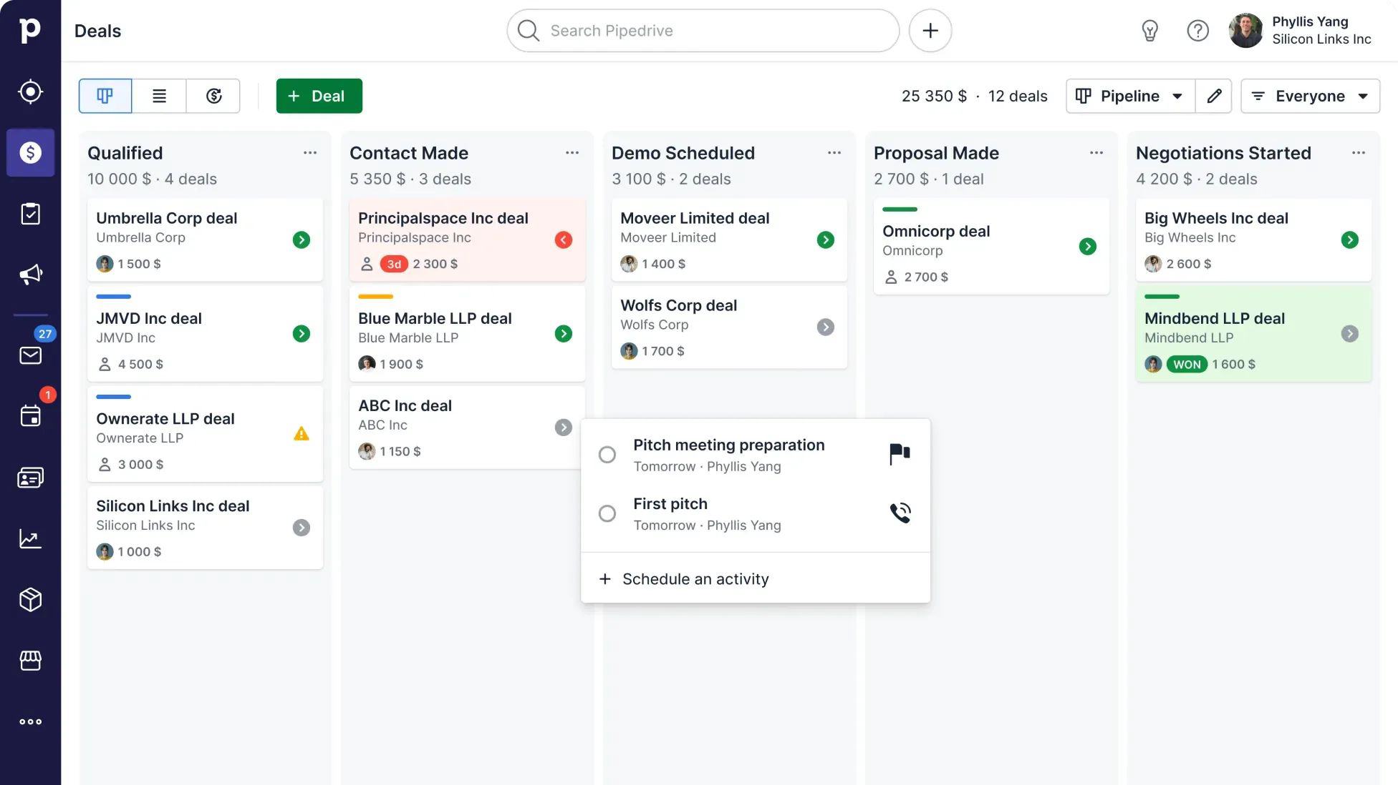
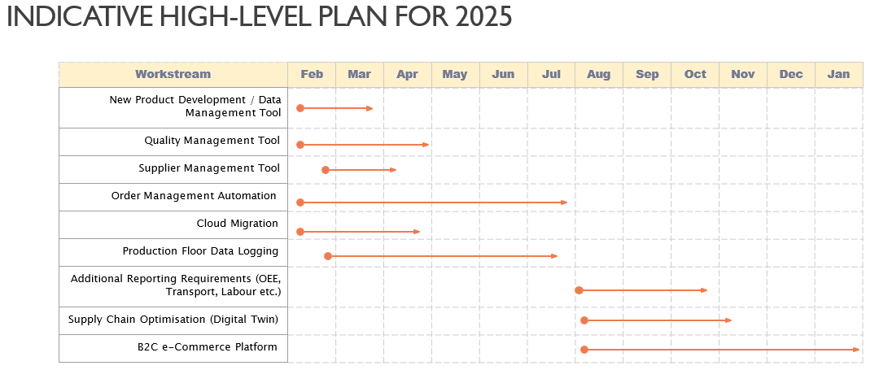
Results
Increased visibility of the Clients sales pipeline and sales activity – particularly in markets outside of Ireland
Centralised customer information and interactions, from prospect right through to in-life. This makes it easier for us to manage and ensure we are hitting our SLAs
Improved reporting and communications of sales performance - owned by the Sales Team and will be used for management team meetings
Future Steps
Integrate Pipedrive CRM with Power BI, SAGE200 and order management system to ensure data consistency

Slide 10
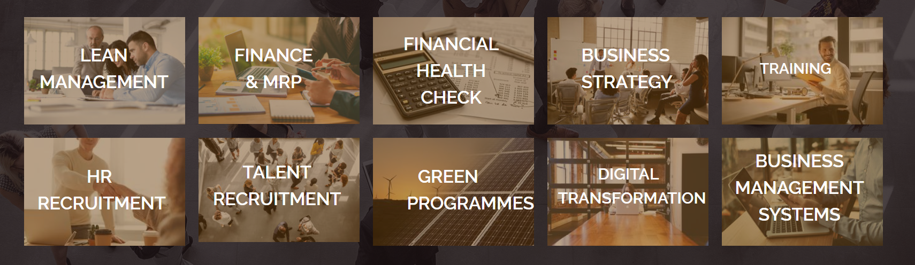
PA services
www.pembrokealliance.com
DELIVERING RESULTS THAT LAST

Slide 11
What we are looking for today
We are seeking Partnerships
where we can provide our professional services, business transformation & delivery expertise to help your clients or your business transform to a leaner business model.
We have been in business for over 12 years and are looking for a platform or managed service partnerships where we can use our expertise in digital in the Food, Construction, engineering or technology sectors to go to market together to help you and your clients transform their business.
Innovation Exchange – Self Diagnostic…
Have you built something that is targeted at, or transferable to the sectors we work in, but don’t have an implementation partner?
Do you miss opportunities because you lack industry knowledge?
We partner with companies where we both add more value to clients as a team rather than on our own.
What do we do to gain our clients trust?
Recognised Industry experts who have run companies in the industries that we transform.
We deliver transformational impact to EBITDA not just advise clients what they should or could do.
We are focused and clear on our business and where we need to partner.
We deliver at the right pace of change that your clients business can handle.

Slide 12


Ideal partner & HOW to engage
Go to Market
Reach out to
scott@pembrokealliance.com
or jdaly@pembrokealliance.com
Sign NDA,
Workshop,
Agree to Go to Market strategy
Our Ideal partner
Pitch/Demo setup
Has a platform that targets exporting or companies in the following sectors:
Financial Services, Technology, Food, Manufacturing, Engineering or Construction
Needs support with Technology challenges

Slide 13
THANK YOU
Key contacts
Scott Bewley
Digital Partner
Mobile: + 353 87 627 4777
email: scott@pembrokealliance.com
John Daly
Chairman
Mobile: + 353 86 252 5127
email: jdaly@pembrokealliance.com
Website www.pembrokealliance.com

