Slide 1
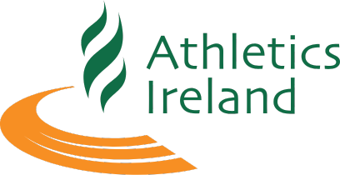
Inventory Management System
Athletics Ireland

Slide 2
Athletics Ireland is the National Governing Body for athletics in Ireland. Our primary objective is to promote and develop the sport at every level from recreational running and school’s competitions through to supporting Ireland's elite athletes in international competition. We are administered by a full-time staff of 40+ employees based in Dublin and the regions and governed by a voluntary Board
Athletics Ireland

Slide 3
Challenge
We require an Inventory Management System.
Purpose is to support the stock management and allocation of new Adidas kit that arrives in January 2025
No retail requirement

Slide 4
Key Deliverables
Track Inventory
14,000 items of stock
300 individual lines
All clothing
Control stock levels
Handle orders and returns
Reports

