Slide 1

The Challenge - Training Automation
Mairead Murphy May 2025

Slide 2

Company Information
Celtic Linen began as a small domestic laundry in 1926.
Now one of the leading service providers in the business and is owned by Johnson Service Group Plc.
Under Johnsons Ireland, the group includes Johnsons Celtic Linen, which operates plants in Wexford and Naas, as well as Johnsons Belfast.
Johnsons Celtic Linen Wexford has a workforce of approximately 360 employees and 50 in Naas

Slide 3

Scope
We are seeking innovative solutions to enhance our current manual onboarding and training processes, which are primarily reliant on limited digital tools that lack integration. The goal of this challenge is to develop cohesive, automated systems that streamline these processes, improve efficiency, and create a seamless experience for new and existing employees.

Slide 4
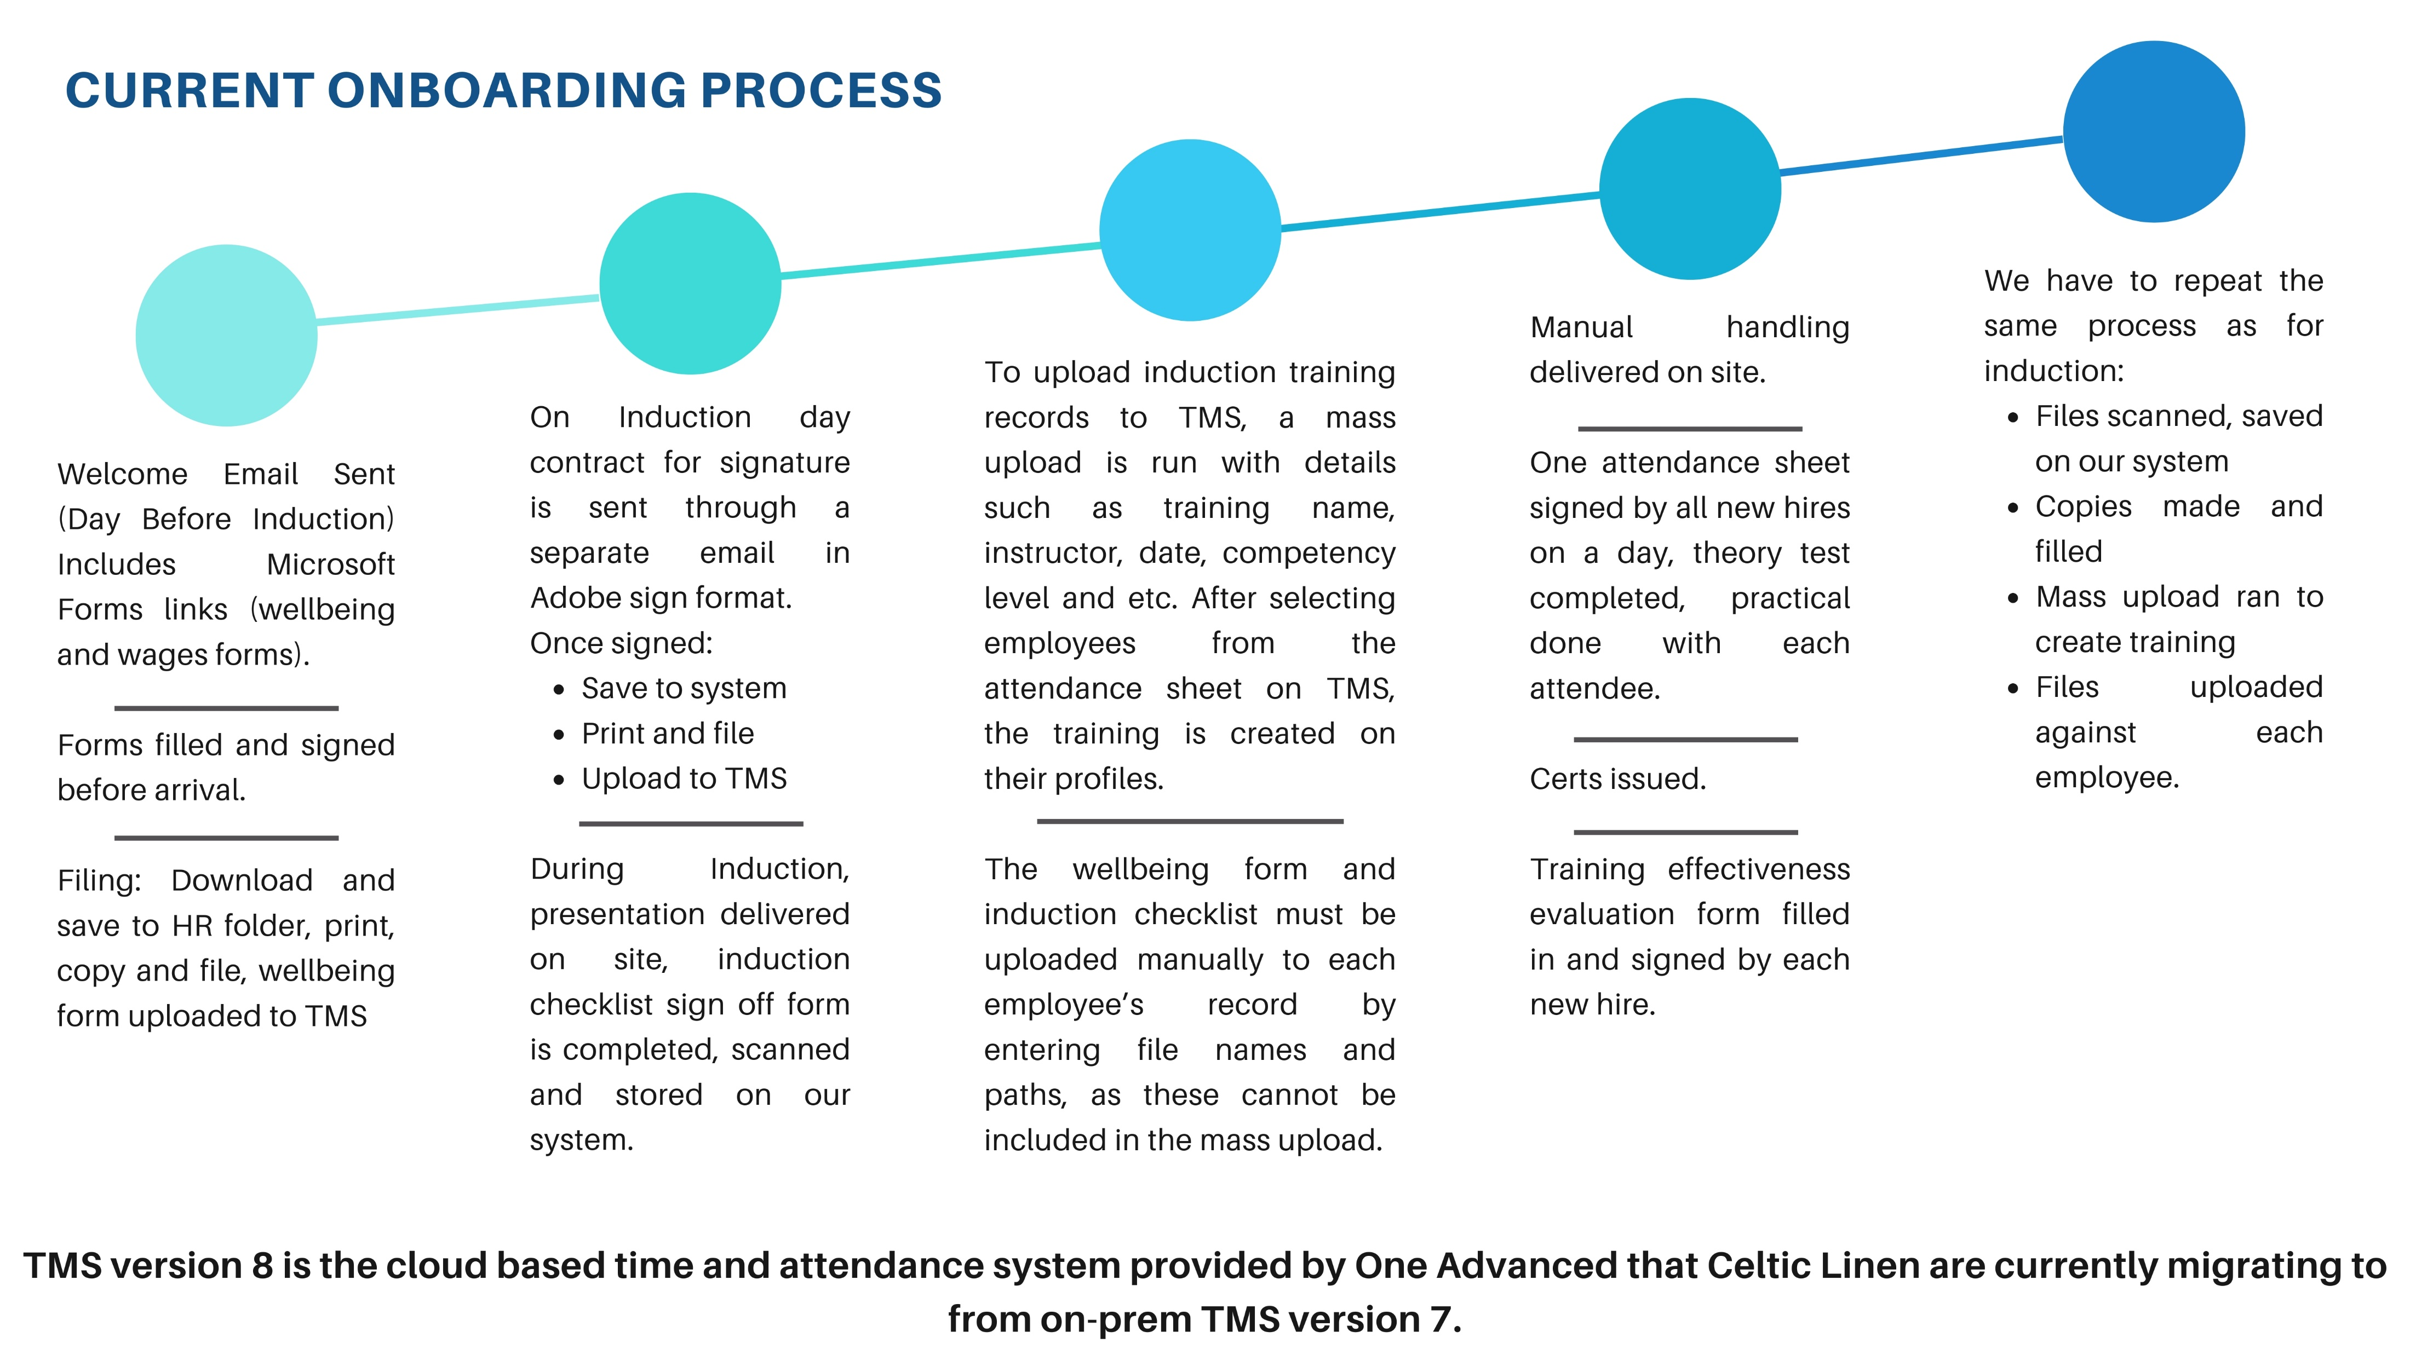

Slide 5
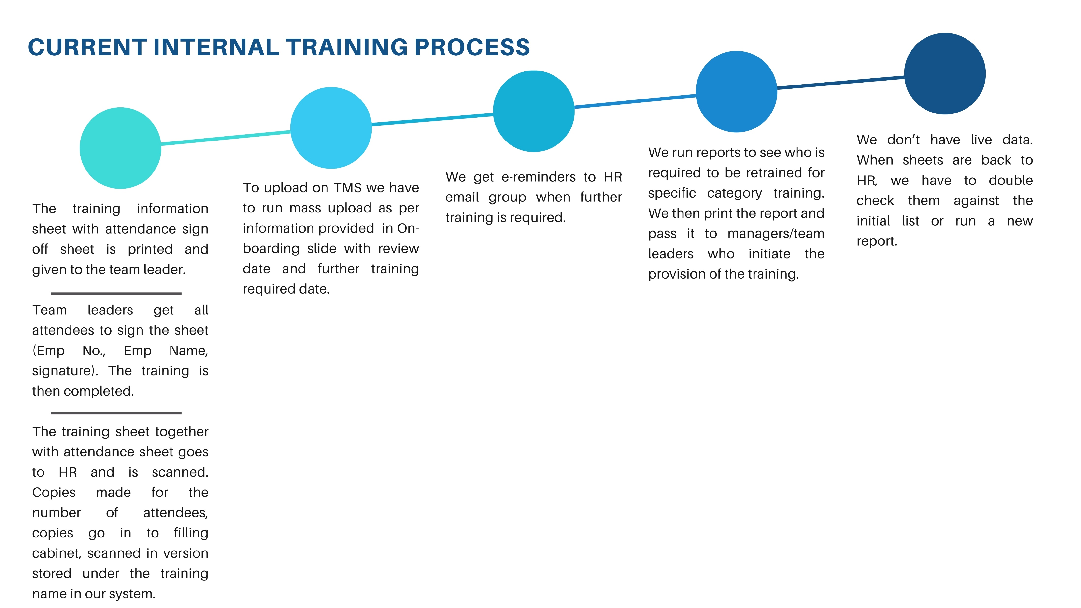

Slide 6
What we would like
Pre-Boarding Preparation:
  Automated Access to Onboarding Materials: Before the new hire’s first day, as soon as the new hire’s account is created on TMS, the new system linked to TMS , should create a mirrored training profile automatically enrolling them in required onboarding courses such as induction, through blended training, manual handling theory with practical part to be scheduled on site, company orientation, compliance training, and role-specific training. Induction, manual handling theory and other trainings should be able to adapt video format without a possibility of skipping any parts for completion, questions should form part of final result and determine whether training is complete, or new hire should repeat it.
  Personalised Training Plans: The system should automatically generate a personalised training plan based on the employee’s role, department, and location. This plan will outline required training courses, certifications, and resources which automatically links to skills matrix.

Slide 7
Onboarding Process:
  Welcome Portal: Employees can access a welcome portal that includes introductions to the team, key contacts, and a calendar with scheduled activities or milestones for their first few weeks.
  Document and Policy Acknowledgement: Employees should be able to review and acknowledge important documents like company T&C’s, policies, and safety protocols digitally. There should be an option for mandatory acknowledgements. Reminders should be sent out daily/weekly until acknowledgment is received with the option for push notification. Acknowledgment should be by way of digital signature and a timestamp. This access to portal should automatically close once a termination has been applied on TMS. It should have an option to also manually terminate.

Slide 8
Tracking Progress and Compliance on both New and Existing Employees:
  Progress Monitoring: The system should track the new employee's completion of mandatory courses, quizzes, and certifications, providing managers and HR with real-time reports on their progress, notifying HR on the theory test has been successfully complete. We can then arrange for practical side on site.
  Automated Reminders: when setting up training on the new system the option to select automated reminders to go to HR with the option of also choosing to go to employees if necessary if any tasks or training are pending or overdue, ensuring that onboarding stays on track. Ability to push notification if required.
Role-Specific Training:
  Role-Specific Learning Paths: Performance reviews, promotions, or role changes can trigger new training requirements.
  Mentor Assignments: The new system may include a feature for assigning mentors to new employees. Mentors can guide them through their onboarding journey, answer questions, and provide hands-on support

Slide 9
Integration with Time Management System (TMS):
  Employee Number Assignment: As part of onboarding, once their profile has been created on TMS, the proposed new training system should be linked to TMS so that it automatically mirrors the profile of the employee and generates a training plan for that person.
  Training Record Syncing: Any training completed during the onboarding process should be automatically synced with the employee’s training records on TMS, ensuring that all training is tracked within TMS system for future reference and compliance.
Documentation and Compliance Tracking:
  Record Keeping: All trainings, documents, certifications, and acknowledgments should be automatically stored on TMS and on the new system for easy access and compliance audits.

Slide 10
Post-Onboarding Check-In:
  Probationary Review Integration: After the onboarding process, managers should be prompted to intermittently review performance. These reviews can track how well the employee is performing, how long is left in their probation and identify any additional training needs.
  Manager Reviews: Managers can assess employees' skills and performance through task assessments/performance reviews and this in turn will allow them to identify the next set of skills or competencies for development. Task assessments should be automatically assigned once the required set of training has been completed.
Documentation and Compliance Tracking:
  Internal training: All training material should be stored within the new system indicating unique training number and revision number. Where a training is updated and revision number changes this should automatically generate a training requirement for all employees who currently hold an old revision number.
  Record Keeping: All trainings, documents, certifications, and acknowledgments should be automatically stored on TMS and on the new system for easy access and compliance audits.
Engagement and Motivation:
  Personalized Notifications: Automated reminders, milestones, and achievements in their training and development should be communicated to employees through notifications, encouraging them to continue with their learning journey.

Slide 11
New System should have
Centralised Platform: A system that allows administrators to create, assign, track, and report on training courses in one place.
Content Delivery: The ability to deliver blended training and diverse content types such as videos, quizzes, PDFs, and interactive courses. Managers, Shift Leaders and Team leaders should be able to deliver training on a factory floor through phones or tablets. Ability to assign multiple employees to one training and ability to request signatures on the spot. Timestamp of the training should be included in every training completed.
Mobile Compatibility: Employees and management should be able to access training from mobile devices and tablets for convenience. Be able to work in offline mode and push sync when wifi is available.
Progress Tracking: Real-time dashboards showing individual and team progress on training programs.
Compliance Tracking and reporting: Automatically remind employees and administrators about necessary certifications and compliance training. Compliance and Certification Report to shows the status of employees’ compliance with mandatory training or certification and helps track certifications that are due for renewal.
Automated Certification Issuance: Generate and issue digital certifications upon course completion, with expiration dates and renewal tracking.

Slide 12
New System should have
Instructor-Led & Online Learning: Support for both virtual instructor-led training (VILT) and self-paced online courses.
Easy Course Creation: The ability to create training content quickly, even without technical knowledge, using drag-and-drop course builders. Ability to assign frequency, reminders. Have an option for specific fields to be visible only under certain log ins (Managers/departments).
TMS Integration: Sync employee data with the system to automatically enrol staff in particular training based on job roles, seniority, or other criteria.
GDPR & Local Regulations: Ensure the system adheres to regional and international data protection regulations with notifications to delete old, expired files that would go beyond GDPR requirements. Employee marked as a leaver on TMS should automatically be excluded from future reminders or any other communication. Training record should be kept as per GDPR.
Progress Alerts: Notify HR when employees complete theory stage in training and would require practical part to be scheduled on site. Reminder to HR that certain training hasn’t been completed by an individual.

Slide 13
Desired Features
Single Sign-On (SSO): Simplify user access to new system by allowing staff to log in with their existing credentials from our TMS log in.

Slide 14
Reports
  Training completion report to track which employees have completed required training and certification. Display completion date, progress and outstanding courses.
  Employee training history report to provide a detailed history of all training courses completed by each employee including certifications and dates. Be able to select recent or historical.
  Training history report to provide a detailed history of all current employees who completed this training including emp no, name and dates. Be able to select work area, department, site code or all.
  Training Attendance Report to lists employees who failed or missed scheduled training sessions or courses.
  Learner Progress Report to provides a snapshot of each learner's progress through their training plan and displays courses completed, courses in progress, and any overdue training (training matrix).
  Training Cost Report to tracks the cost of external training programs.
  Training Cost Report to tracks the cost of internal training programs.
  Digital evaluation Report to gain feedback on training delivered (weekly, monthly count on training hours. Weekly monthly count on heads trained etc.
  (PERHAPS THE ABILTIY TO BUILD OUR OWN REPORTS TO COVER ALLT HE ABOVE AND MORE)

Slide 15
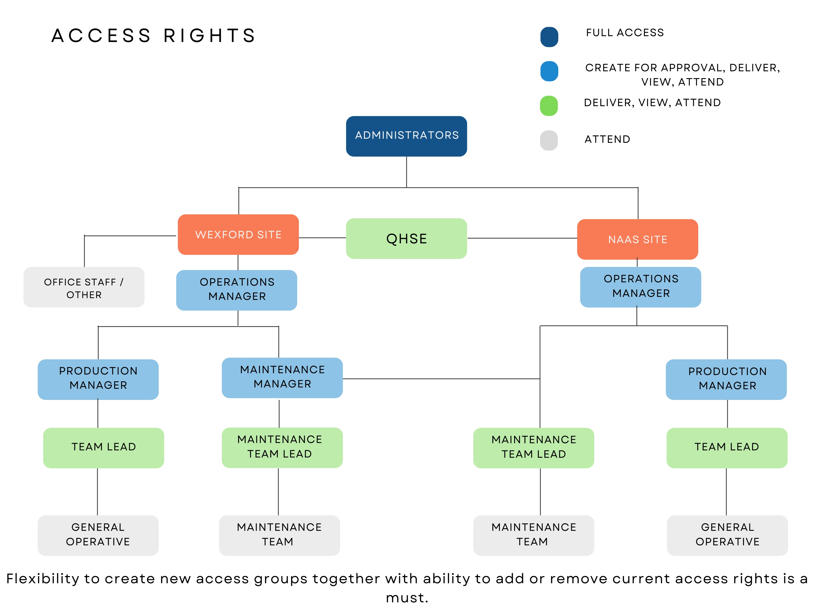

Slide 16
Note
Previous online training providers have advised that their systems were unable to link with TMS.

Slide 17
Thank you
Questions

