Slide 1
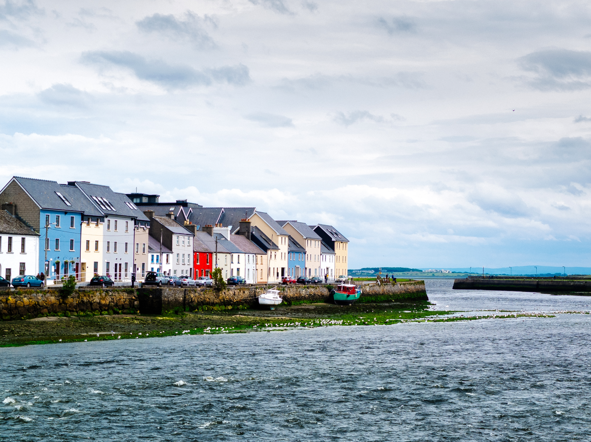

Galway City Council
Our Challenge
17 July 2025

Slide 2
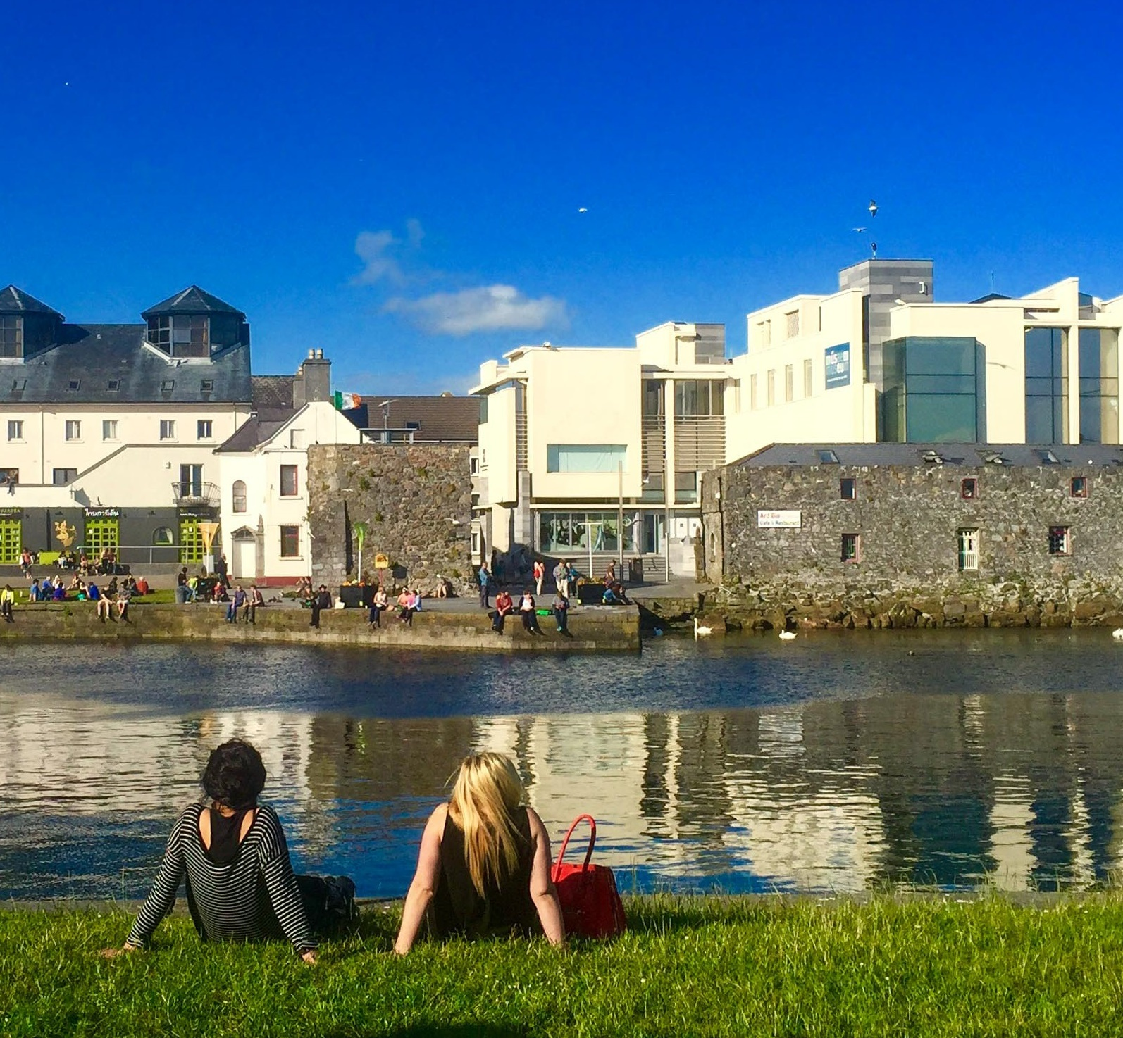

Galway Tourism
Stats & Figures
    Over 1.8 million international visitors and 1.2 million domestic visitors
    A Year- Round Tourism Product
    10 – 12% of Employment is in the Tourism Sector in the city
    7 Months of the year we have above 80% Occupancy

Slide 3
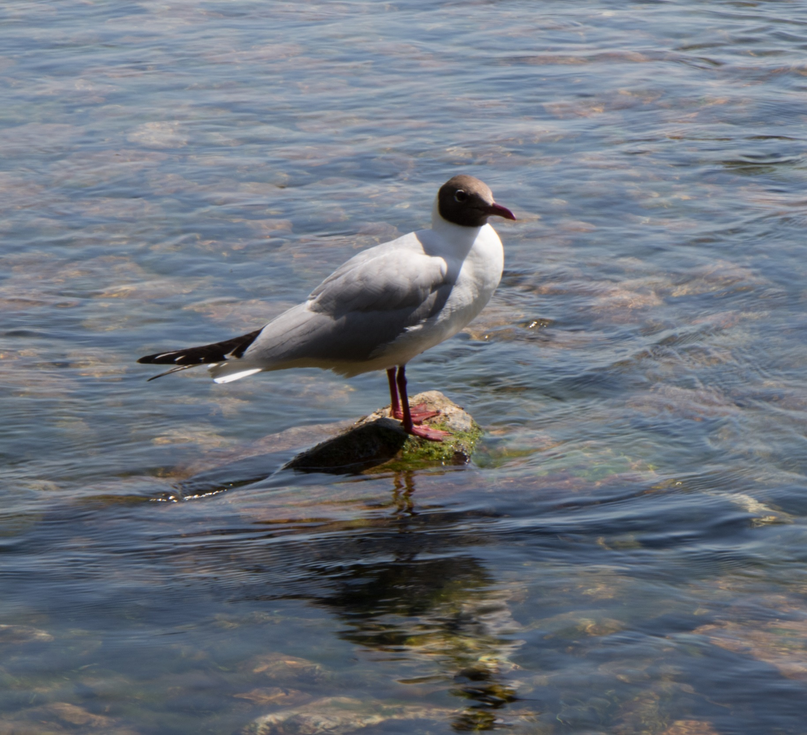
Visitor Satisfaction Survey Results
Dropping Visitor Satisfaction Rate
The incidence of visitors who feel Value for Money is ‘very poor’ in the city has significantly increased
Availability of locally produced food
Evening activities are priority areas to improve
Limited Information on what’s on

Slide 4

The Visitor Journey
- Visitors are landing Galway City in Eyre Square, walking down the pedestrian Street to the Spanish Arch and returning to Eyre Square with the impression they have seen Galway City.
- Galway City is being used as a hub to visit other places. Visitors are overnighting in Galway City to and spending their daytime at the Aran Island, Cliffs of Moher and Connemara

Slide 5
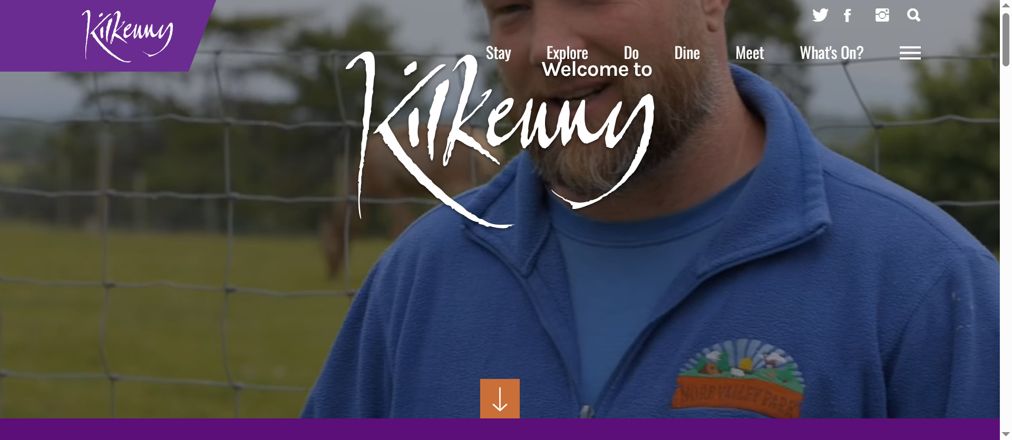
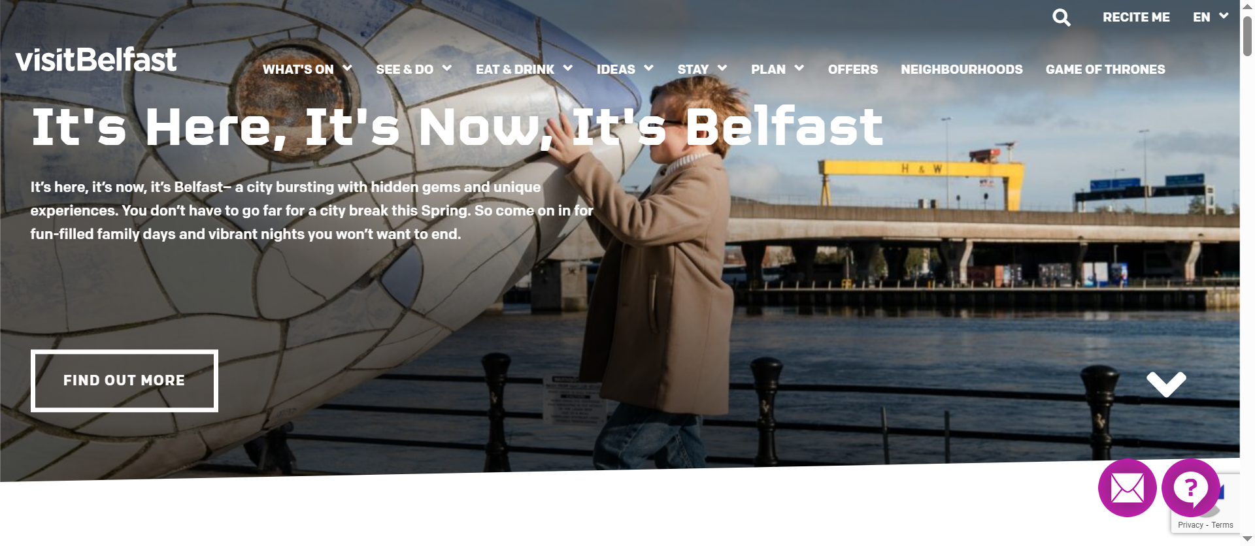
Tourist Information
Galway City does not have an official Tourist Information website or social channels.
A number of sites exist but the service is inconsistent and often inaccurate

Slide 6
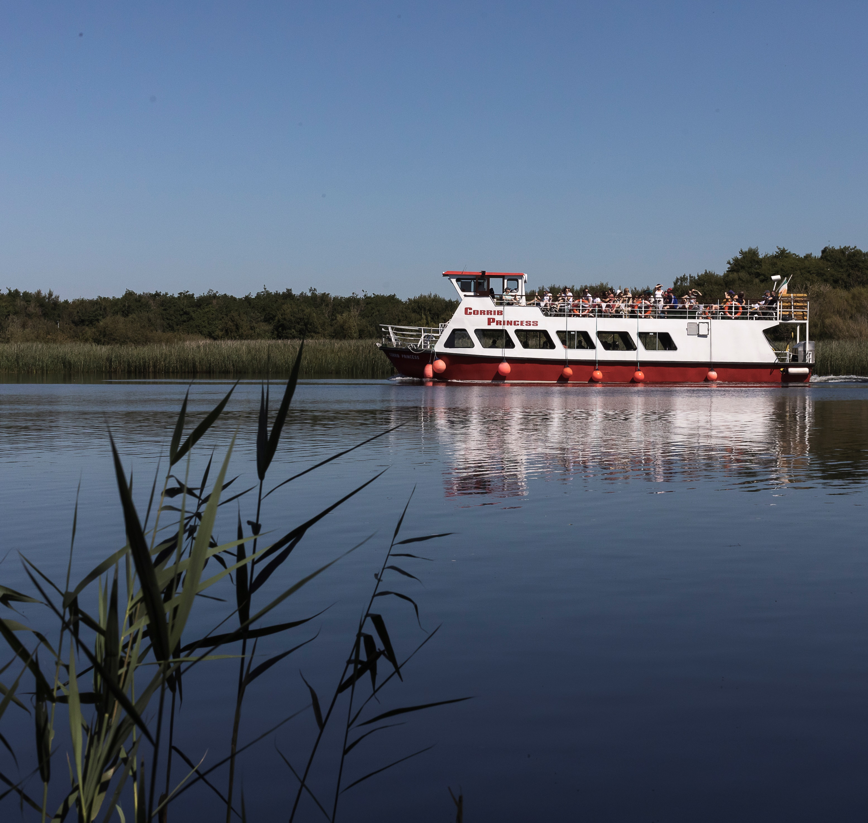
Our Challenge
A new Tourism Website for Galway City

Slide 7
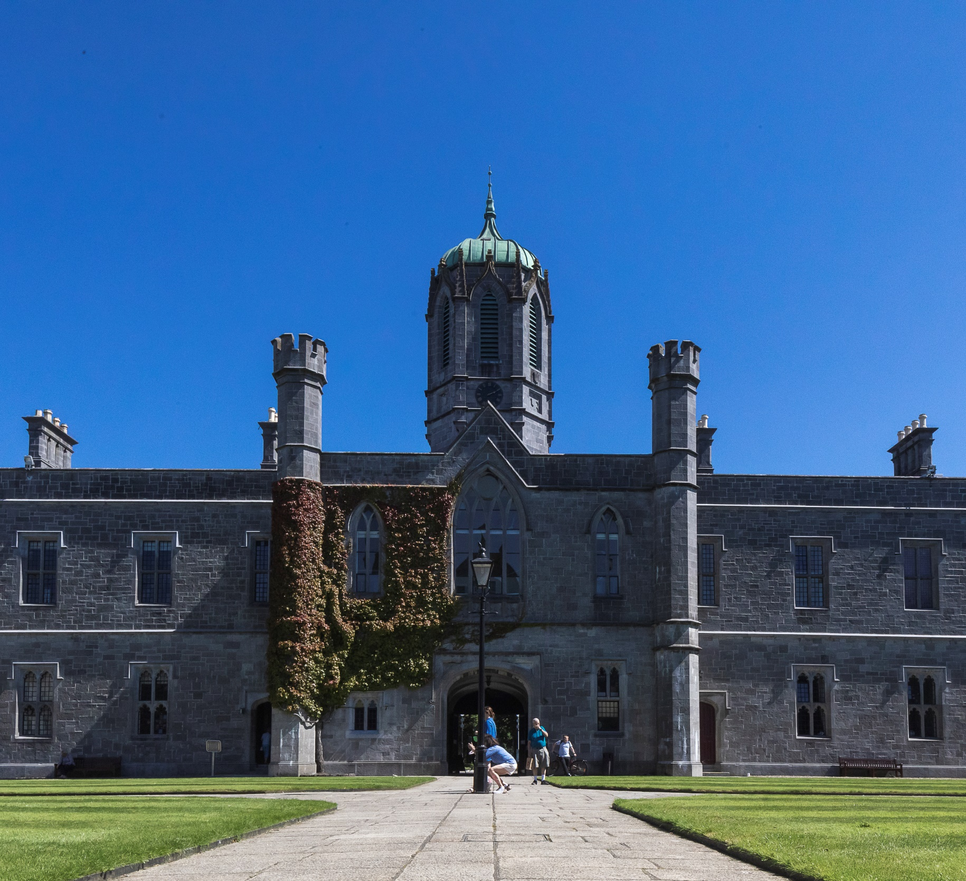
A New Tourism Website for Galway City
₄%
Limited Resources Internally for updates
Industry Update Tool
Suitable for a City with 122 annual Festivals
Available Bi-Lingual
Automated Personalised Itineraries
Simply proofing and updating system

