Slide 1
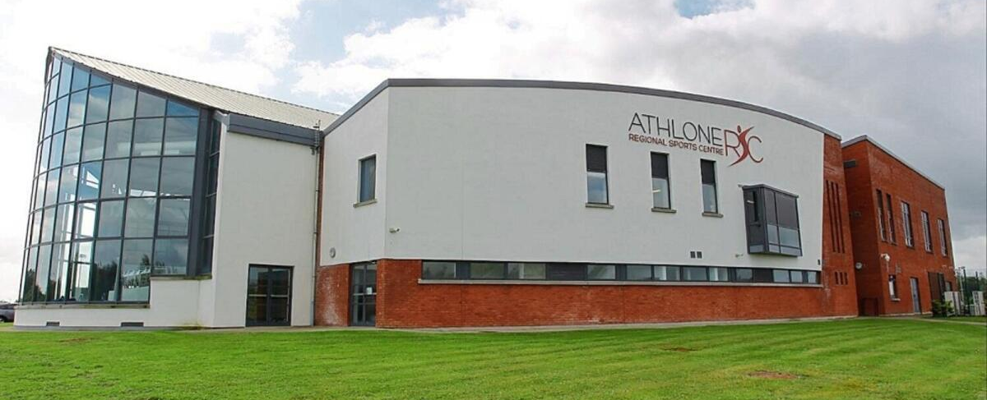

The Challenge - we are trying to solve.

Slide 2
Athlone Regional Sports Centre (Athlone RSC)
Location: Brawny Road, Athlone, Co. Westmeath
Type: Public Leisure & fitness facility serving the Midlands region – Non Members (PAYG) & Members
Mission: Provide a welcoming, inclusive environment for all ages and fitness levels, reinvesting profits into improving facilities and services for the community.
Facilities: Fully equipped gym, Fitness class studio, Spin Studio, Milon area, 25m swimming pool with sauna and steam room, small kids pool, changing rooms
External - playground, skatepark, café, Hockey Pitch, 5 a sides, and free parking
Outdoor Fitness Park with trails, Basketball, pétanque, pickleball, sensory garden, outdoor gym equipment, wheelchair accessible gym equipment, and children's play areas (climbing pyramid,tag zone, labyrinth, pirate island)
Recognition: Holder of the National Quality Standard for safety, hygiene, maintenance, and customer care

Slide 3
Athlone Regional Sports Centre (Athlone RSC)
Opened in 2002 – lot of improvements in that time
Now Over 3000 adult members (not including children)
Over 360,000 visits internally each year
On a 26 acre site
Building itself – over 3,500 sqm
Open 7 days a week
  6.30am – 10.00pm- Mon – Fri
  8.30am – 6.00pm – Sat & Sun
Over 50 staff – 70% part time

Slide 4
The Challenges
1.Reporting and tracking maintenance issues
Reporting & Tracking Maintenance Issues
  No automated system for daily recording; currently relies on staff or customer reports.
  No feedback loop to customers once issues are resolved.
  Maintenance issues kept only as a static list.
Maintenance Contract Management
  Lack of structure for tracking approved suppliers, service dates, call-outs, and completed work.
Inventory Management
  Equipment log maintained in Excel with sticker numbers — time-consuming and prone to manual errors.
  No system for managing spare parts inventory.
Area & Issue Updates
  Daily and weekly maintenance updates are list-based and manually compiled.
Contractor Sign-In & Tracking
  Manual sign-in sheets.
  No way to monitor contractor locations in the building, confirm when they’ve finished, or record completed tasks.
Equipment Checks
  Existing QR code system for internal equipment checks (Seachange).
  Plan to extend to outdoor equipment in the near future.

Slide 5
Requirements
Easy Issue Logging
  Verbal and typed input options for both customers and staff.
  Encourages quick and seamless reporting of maintenance issues.
  Captures the exact location of the issue and the person reporting it for follow-up.
Real-Time Reporting
  Instant delivery of reports to the maintenance team.
  Automatic acknowledgements to the reporter (via app, text, or email) when an issue is raised and resolved.
Data & Insights
  Visual dashboard showing patterns, issue frequency by area, and resolution times.
  Historical reporting for trends and planning.
  GDPR-compliant secure data handling.
Issue Management
  Prompts to ensure all reported issues are resolved.
  Tracks contractor work, including method statements and completed tasks.
Maintenance Scheduling
  Calendar-based contract management with alerts for scheduled work.
  Displays completed tasks and flags outstanding work directly in the maintenance log.
Contractor Tracking
  Digital sign-in/out with time on site, work location, and completed tasks recorded.
Inventory Control
  Automated inventory tracking for equipment and spare parts.

Slide 6
Desired Features
Multi-Platform Issue Reporting
  Accessible through the Athlone RSC app or other platforms.
  On-site kiosks in key areas for reporting issues without the app.
Seamless Member & Visitor Identification
  Integration with member RFID wristbands to automatically capture member details.
  Easy option for non-members to report issues.
Role-Based Access
  Different access levels for members, staff, and maintenance teams.
Contractor Management Tools
  Automated prompts, alert messages, and forward-planning capabilities for contractor work.
System Integration
  Compatible with current leisure management software (Legend/Xplor) and adaptable to future changes.

Slide 7
Expected Outcomes
Faster Issue Resolution
  Quicker reporting and turnaround for maintenance and cleanliness problems.
Higher Customer Satisfaction
  Greater transparency and proactive communication with customers.
Reduced Staff Workload
  Less time spent on manual logging and follow-ups.
Better Decision-Making
  Data-driven insights on recurring issues and response times.
Stronger Community Trust
  Visible responsiveness to customer concerns.
Automated Inventory Management
  Reduced manual effort in tracking and updating stock.
Streamlined Compliance
  All maintenance contracts tracked and aligned with the approved supplier list.

