Slide 1

Innovation exchange

Slide 2




Slide 3



Slide 4

Notes:
We are a local manufacturer to Ireland competing against multinationals making products outside of Ireland, a lower food mile option

Slide 5

Sustainability
Energy
Waste
Water
Biodiversity
Community Engagement
Raw Material Sourcing
Product Packaging
Product Health and Nutrition
Employee Wellbeing
Notes:
Since 2023

Slide 6

Our Challenge
Energy monitoring:
As we are currently using manual meter reading data and bill data for our on-site gas usage analysis which is not ideal. We want to have a more in-depth granular understanding of our energy use.
Notes:
Maintenance support is key

Slide 7
Our Challenge
Energy monitoring:
Regarding electricity usage, we are monitoring it with a smart meter system that is plugged into the main control panel giving us a view of all three phases. This system has its issues also.
Notes:
Maintenance support is key

Slide 8
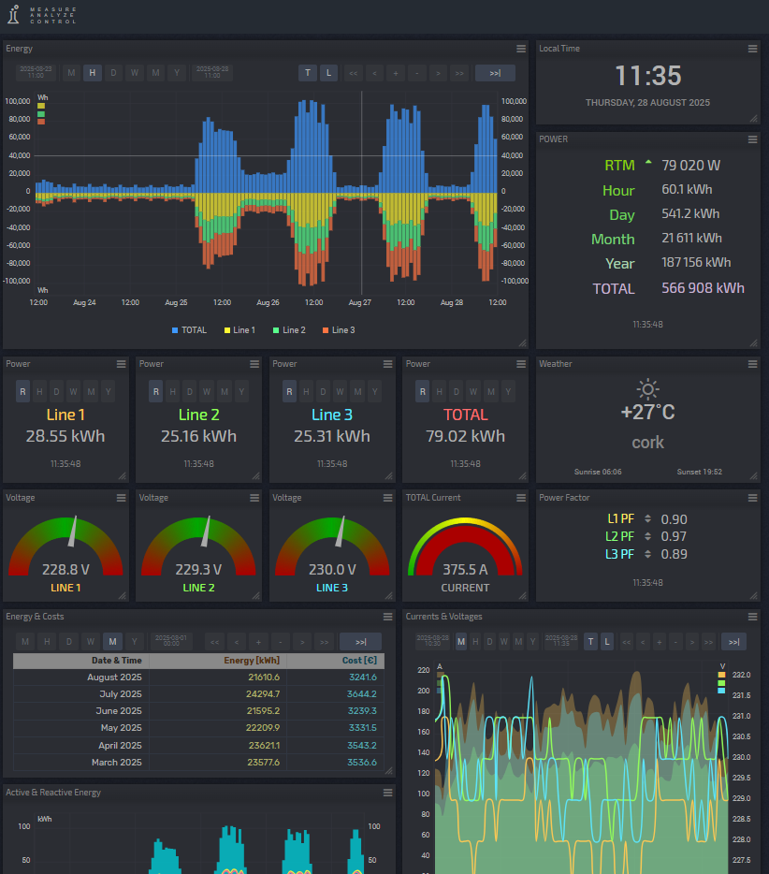
Current electrical monitoring system
Notes:
Maintenance support is key

Slide 9
Why we want to change:
We want to change to a more advanced energy monitoring system where we can have everything e.g., gas, elect,(waste) all in one place so we can set accurate targets and measure our KPIs at an instance.
This saves a lot of admin and excel work also*
Notes:
Maintenance support is key

