Slide 1


Swim Ireland
Skill Net Challenge
8th January 2026

Slide 2
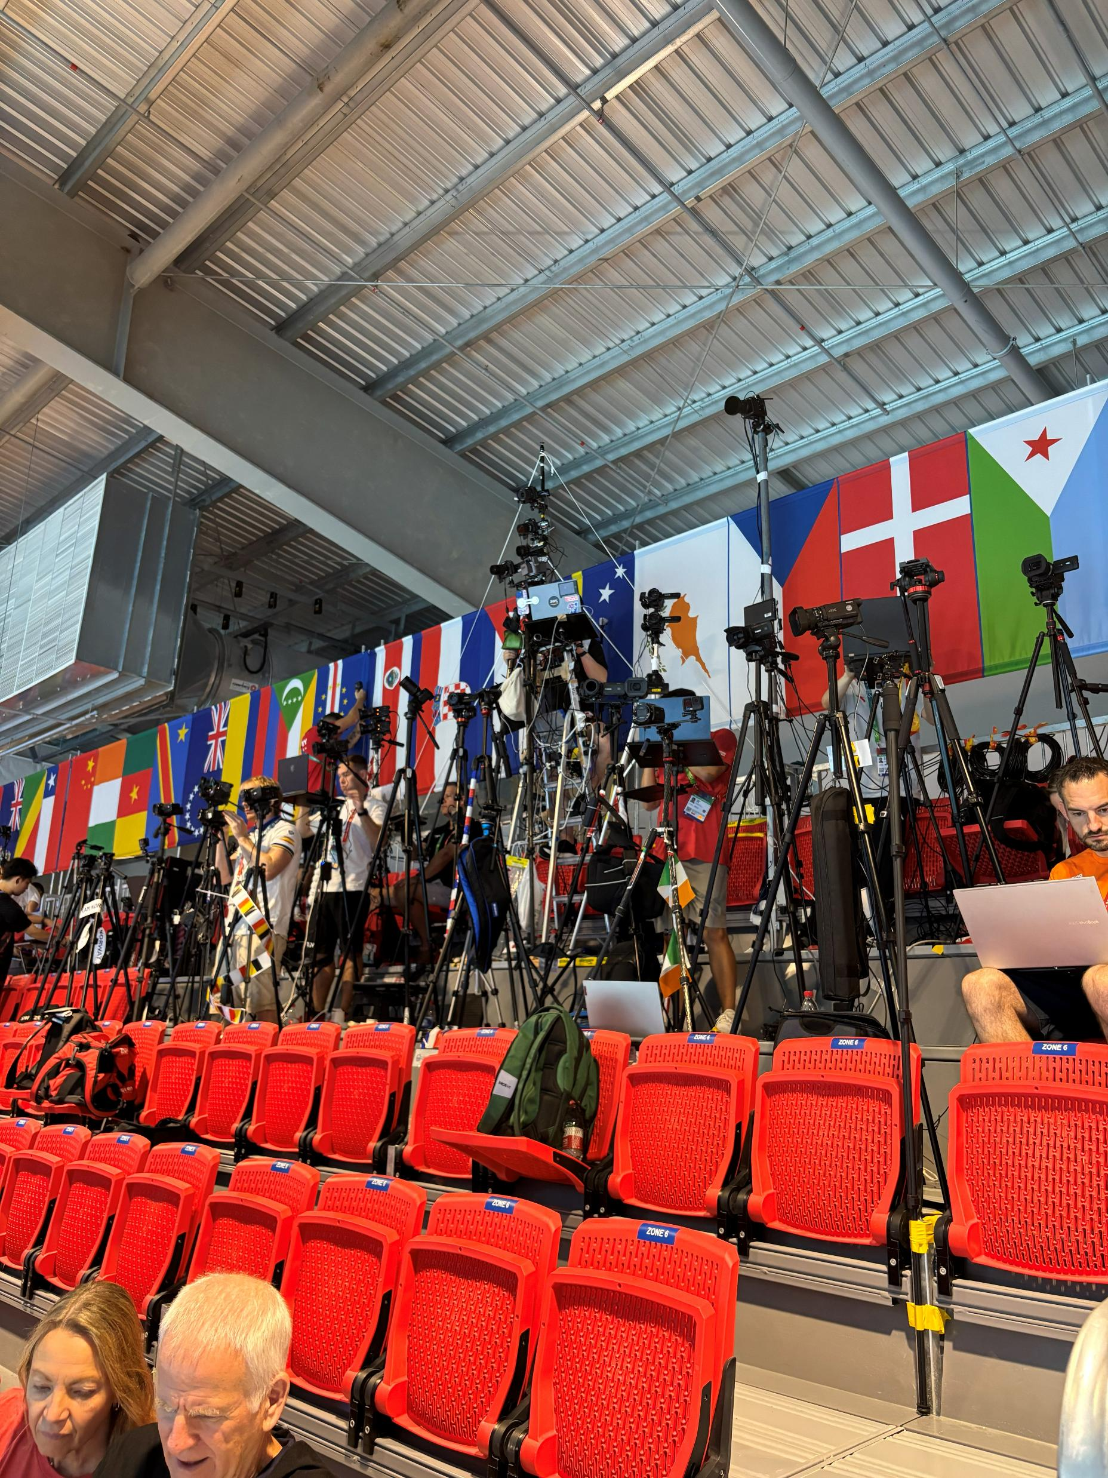
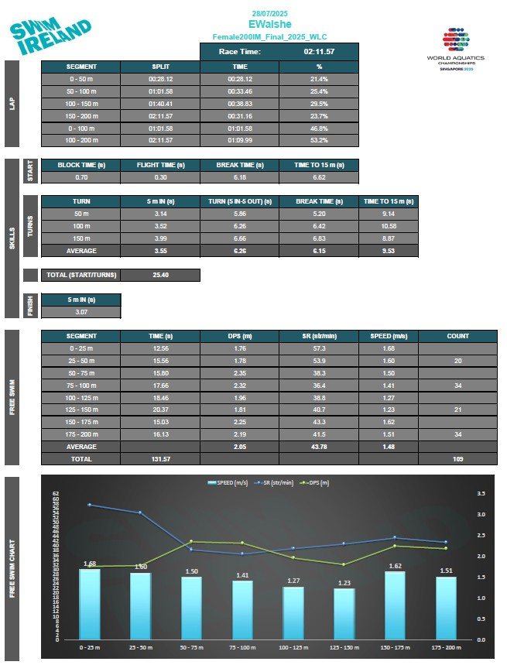
What is the current race analysis process?

Slide 3
There are currently 2 elements where manual input is important
Video capture
Elevated position
Mid way point of the pool
Focus on a single lanes / multiple lanes
Manual Time Stamping
Key time points
Start
Start light
Leaving blocks
Hand Entry
Breakout
Swim
15m Mark
25m Mark
35m Mark
45m Mark
Wall Contact

Slide 4
What is this project?
There are two objectives
Fixed position camera system capable of capturing overhead view of the whole pool
Software / AI tool capable of generating key time points from the footage captured to generate race reports

Slide 5

Stage 1: Fixed Camera System – Requirements & Considerations
Integrated overhead camera angles that capture 50m length & up to 10 lanes (2.5m – 3m Wide)
Accurate sight of key distance markers in the pool (Start, 5m, 15m, 25m, 35m, 45m, 50m)
Remote control ability for capture
Ease of access to captured footage (cloud-based storage, accessible remotely)
Secure storage of captured footage

Slide 6
Stage 2: Software Design – Requirements & Considerations
Accurate timestamping of key time points (0.01s)
Ability to manually review timestamped race positions
PERFORM A RANGE OF CALCULATIONS TO GENERATE GOLD STANDARD RACE DATA
TABULATE AND VISUALISE RACE DATA INTO CUSTOMISABLE RACE REPORTS
BACKGROUND DATABASE OF RACE DATA TO INCLUDE CONTEXTUAL DATA WHERE AVAILABLE

Slide 7
Potential Market
At major international meets each nation has an onsite analyst to capture footage and generate race data
Space is at a premium & capture and analysis processes are time consuming
In many cases analysts compromise volume of data captured / generated due to limited capacity
This system could potentially auto generate race data for all lanes of every race instantly
The solution becomes marketable to any facility that hosts major swim meets globally
The system is perfect for the data hungry market of performance sport and media coverage

