Slide 1
Illegal Dumping in Ballybane
A Galway City Council Conundrum
David Walsh
Waste Enforcement Officer

Slide 2
Background
Illegal Dumping rampant in Ballybane
Mixture of Household, Commercial and Construction and Demolition Waste deposited on street corners, derelict sites, adjacent agricultural land and green spaces
Over 4 Tonnes of Waste removed from Ballybane weekly by Galway City Council Litter Management Unit
CCTV previously in use but discontinued due to GDPR issues

Slide 3
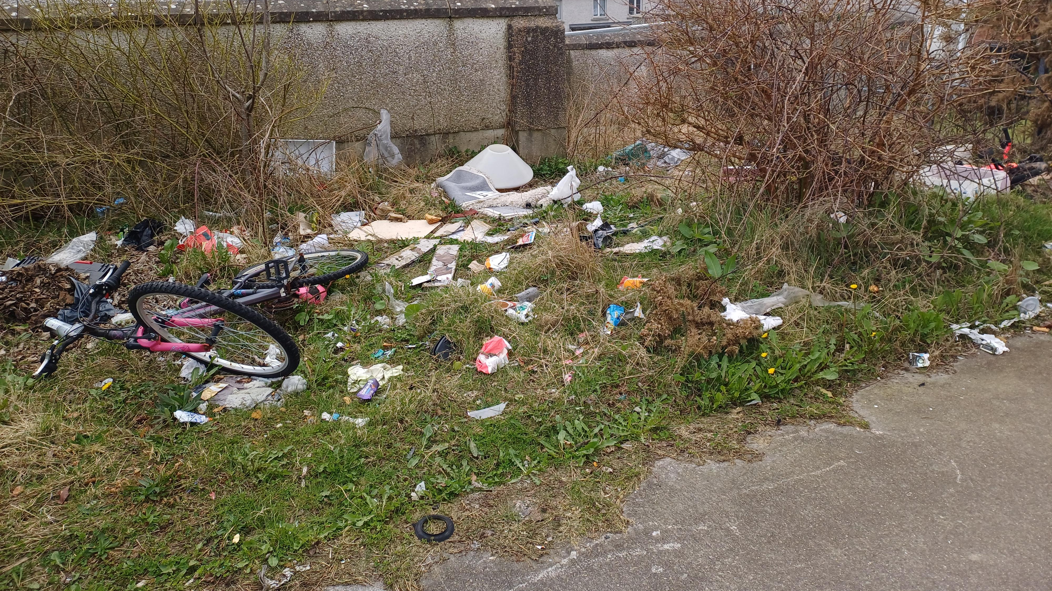

Slide 4
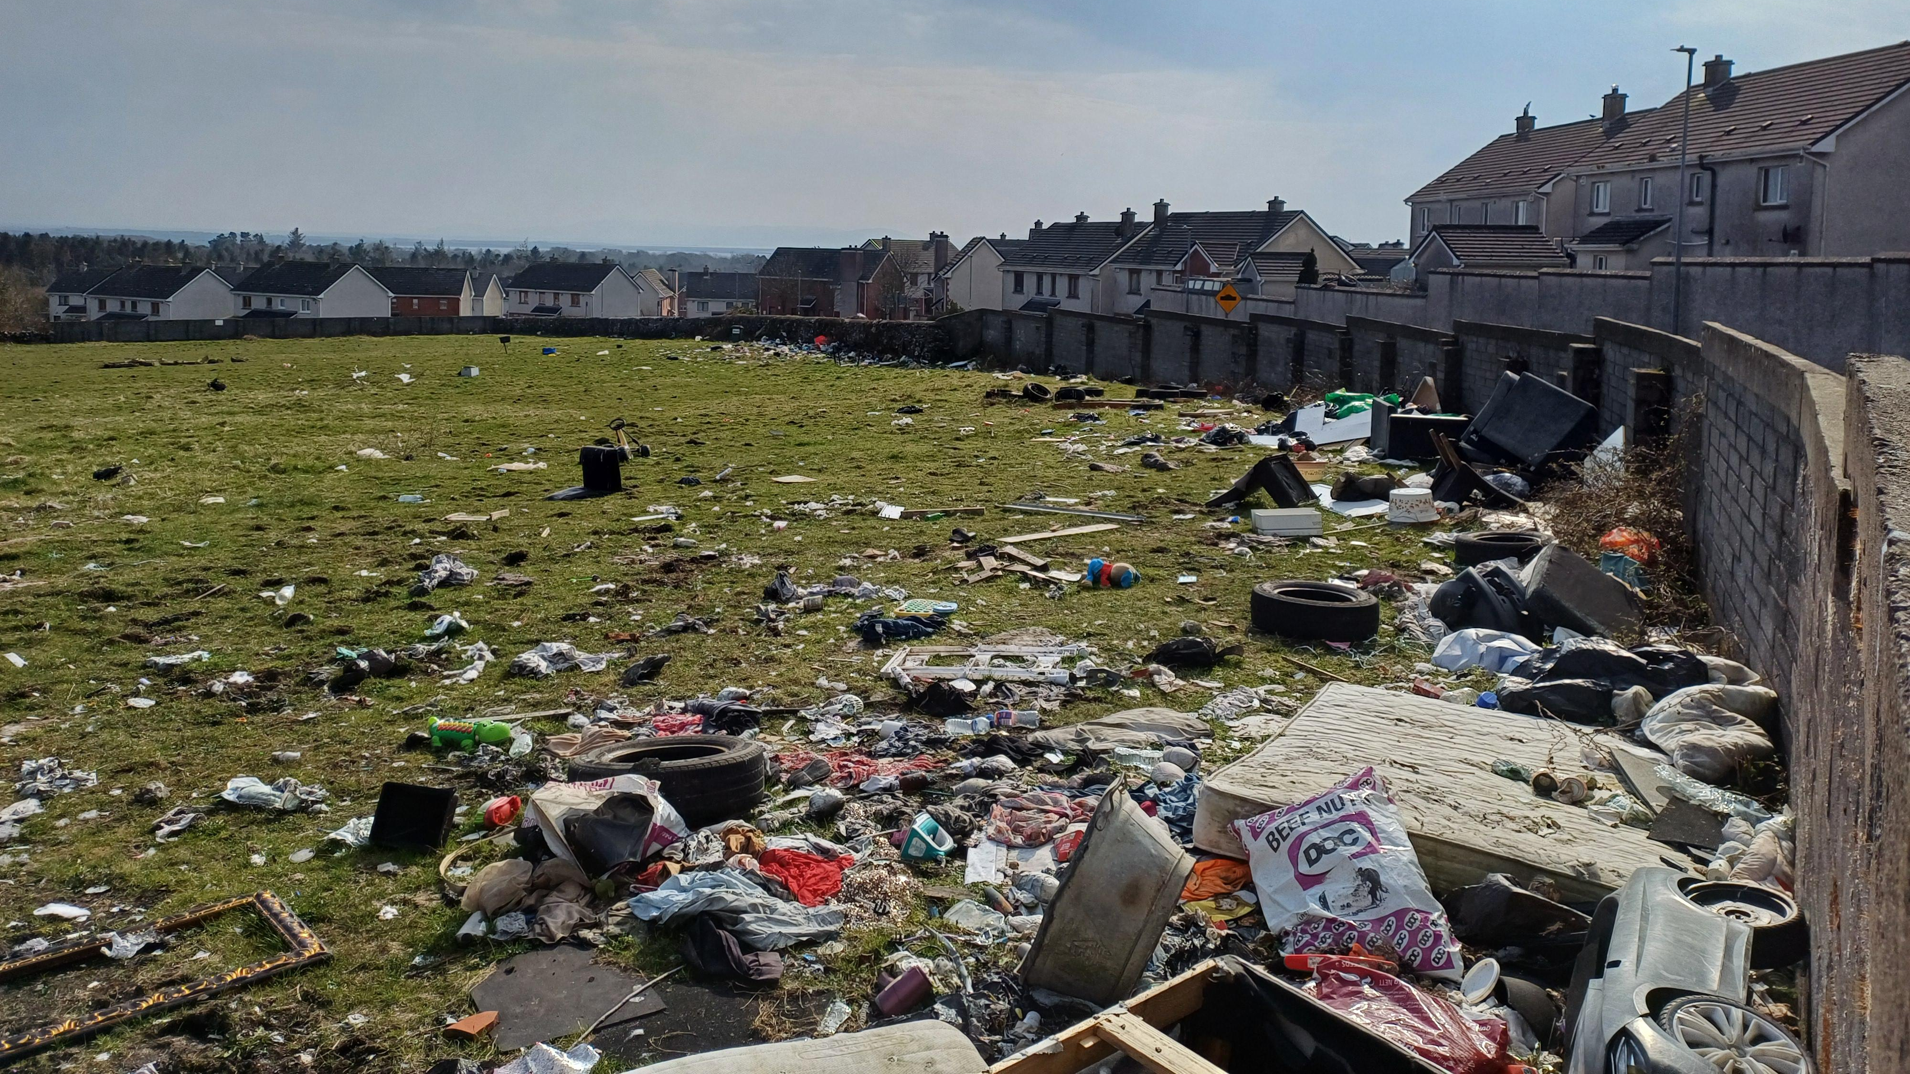

Slide 5
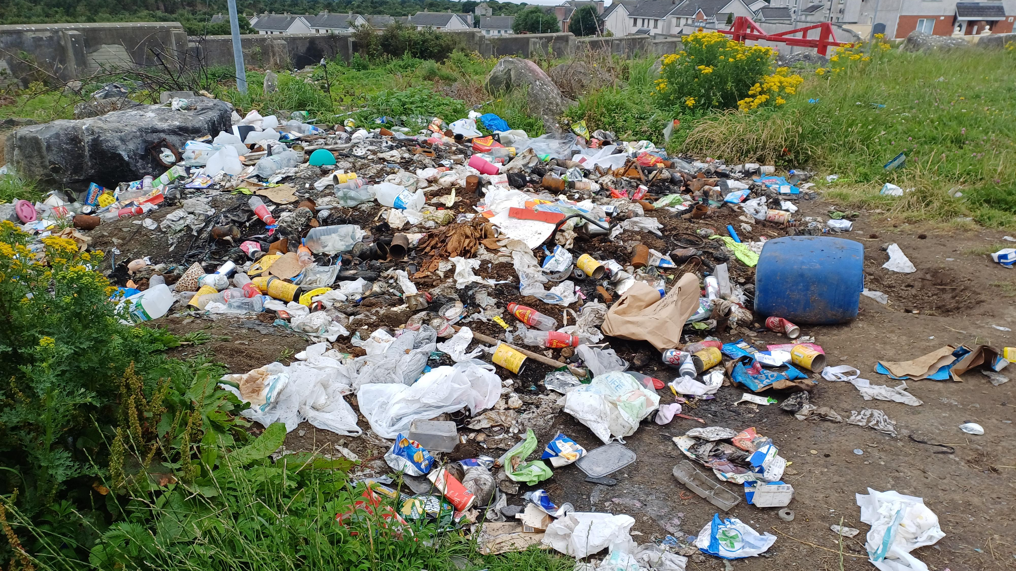

Slide 6
Current Status
Enforcement actions ongoing but proving difficult due to lack of evidence and volume of waste
Huge costs on Local Authority for clean up
Small minority entertain mindset that Local Authority will take waste away
Large Local Authority workload with only two staff available to investigate/negate all instances of illegal dumping

Slide 7

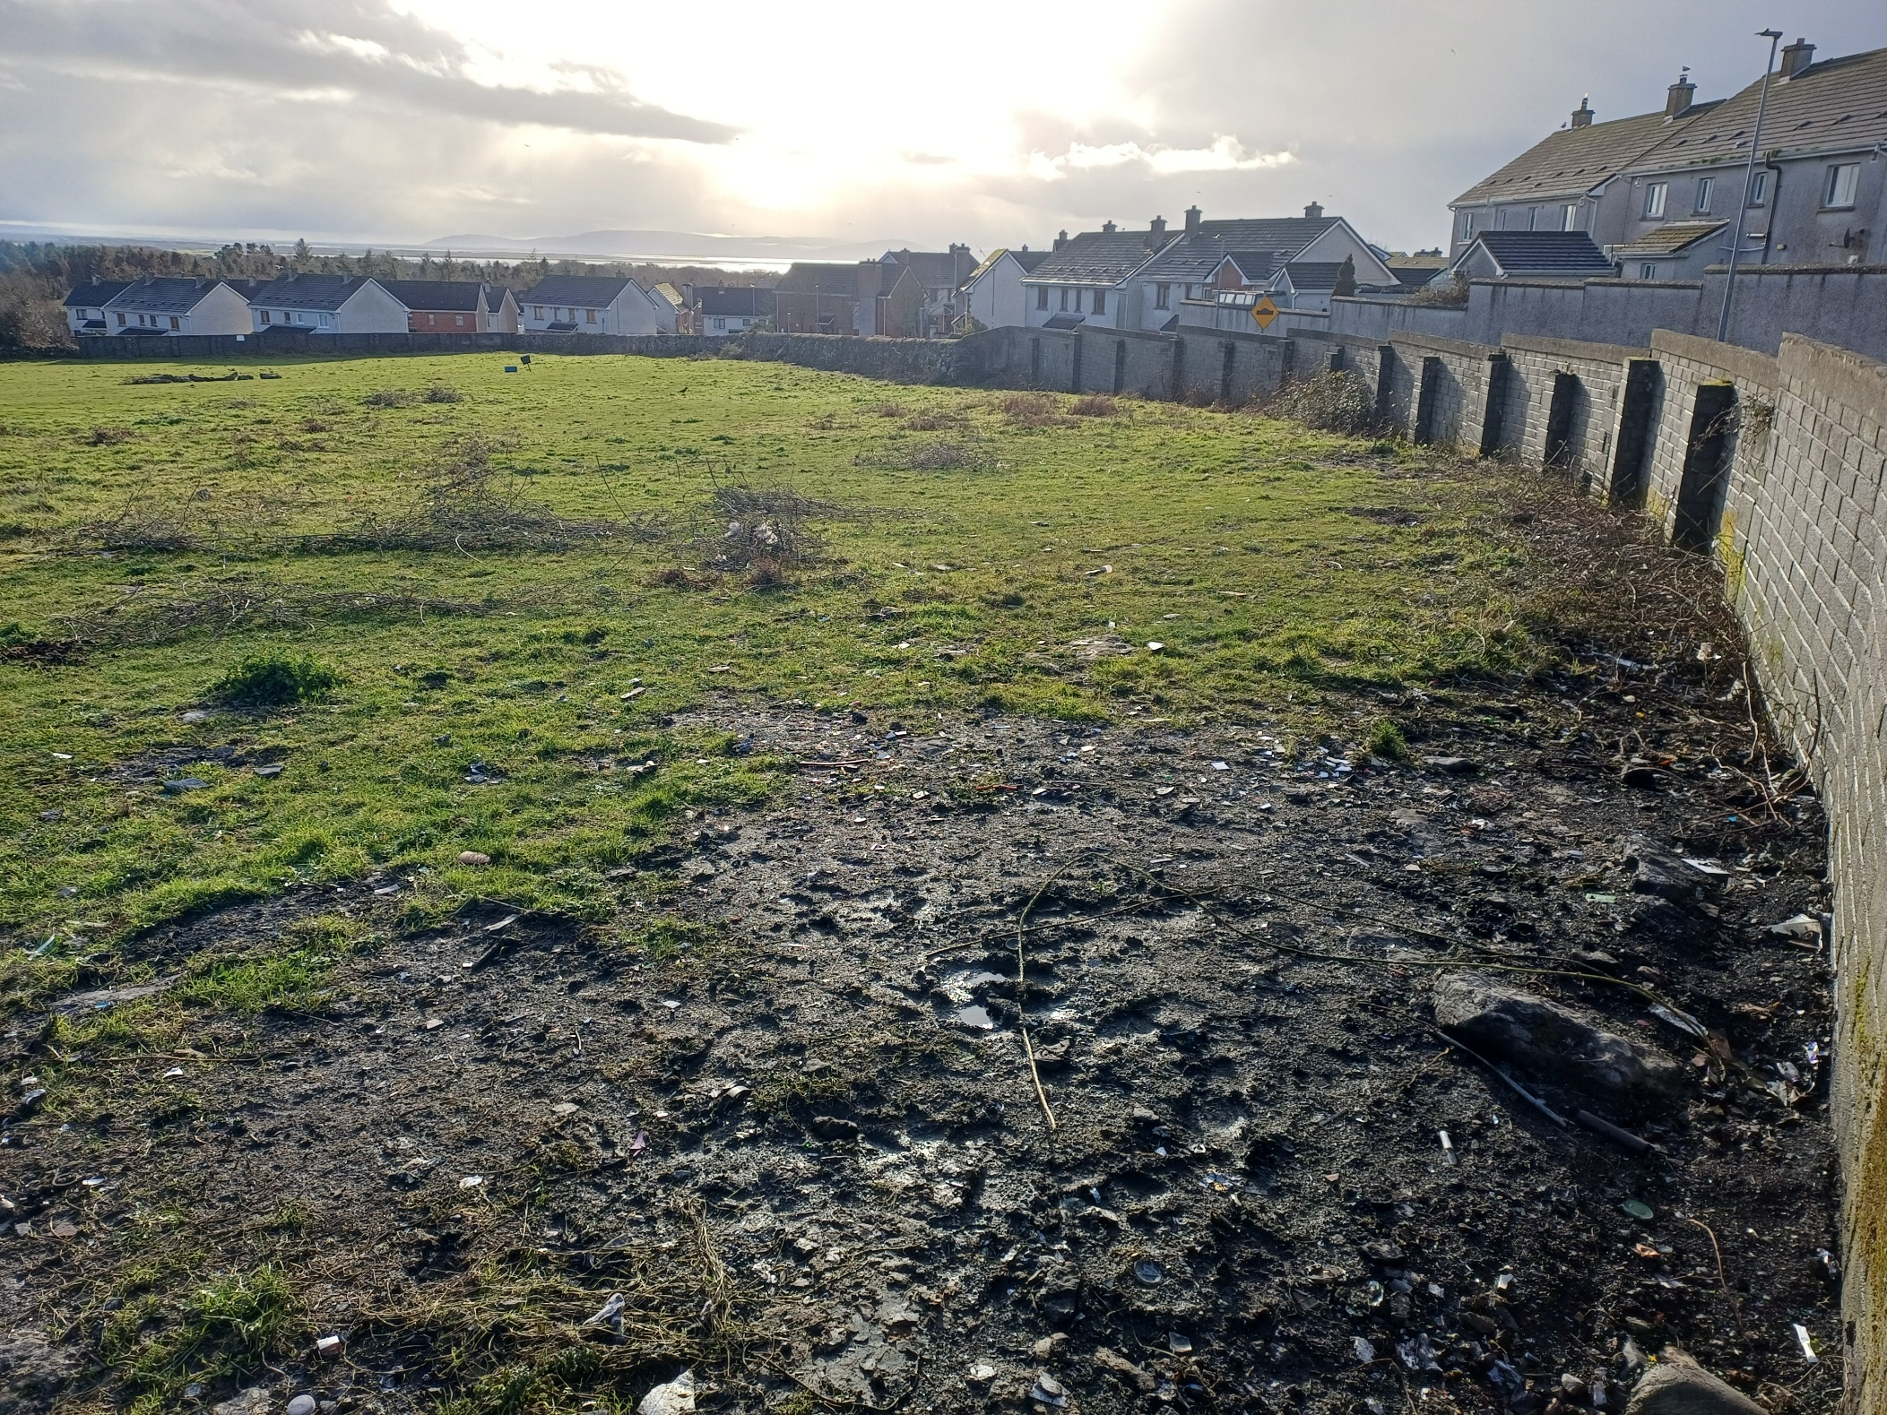

Slide 8
Challenge
Galway City Council seek to procure a software and/or hardware (e.g. cameras) solution that will assist with the;
surveillance, and/or
detection, and/or
deterrence of illegal dumping in all its forms
Any evidence secured will be used in the submission of fines and possible prosecutions under the Waste Management Act 1996, as amended
Overall aim to reduce instances of illegal dumping as well as Local Authority workload and costs
Open to all other ideas to find solution e.g. Artificial Intelligence

Slide 9
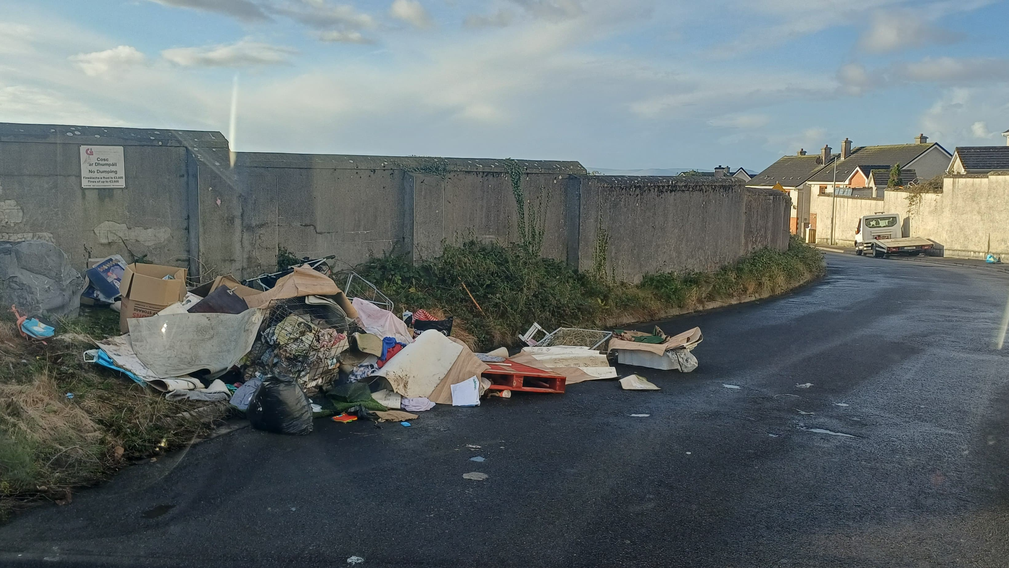

Slide 10
Thank You

